Slide 1
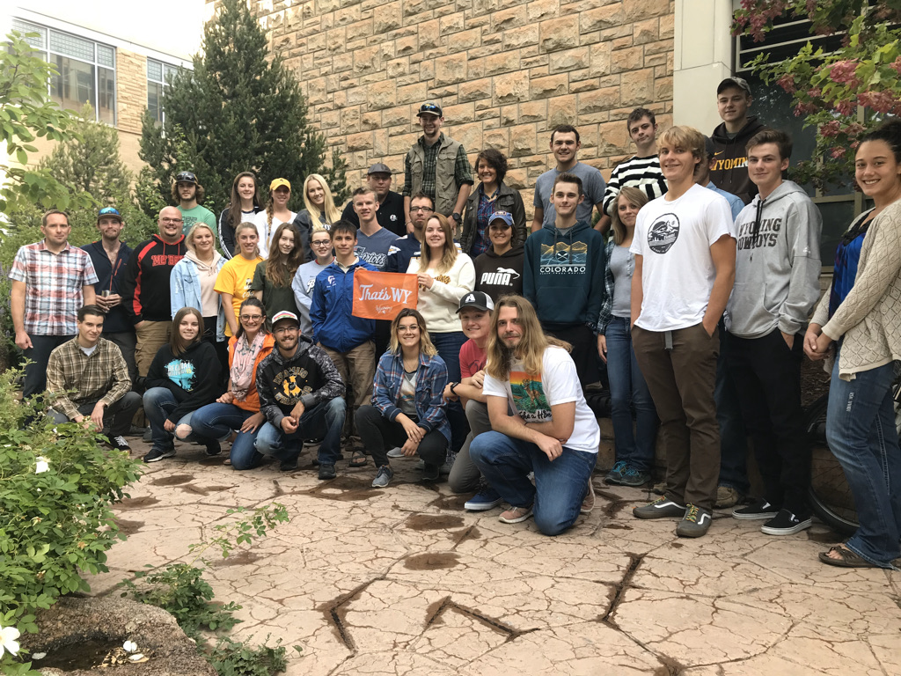
Workforce Panel

Slide 2
Meet your panelists
Dr. Dan McCoy, Interim Director, Wyoming Outdoor Recreation, Tourism and Hospitality (WORTH) Initiative
Amy Madera, Director of Culinary and Hospitality Programs for Central Wyoming College
Molly Matthaei, Culinary Arts Instructor, Jackson Hole High School
Jordan Kobliska, Internship, and Employment Coordinator at the University of Wyoming

Slide 3
Agenda
Job growth projections
Labor force growth
Demographic shifts in the workforce
Discussion

Slide 4
Job Growth from 2018 to 2030
National Restaurant Association 2030 report

Slide 5
Wyoming Long- Term Industry and Occupational Employment Projections, 2020-2030
Wyoming Department of Workforce Services

Slide 6
Wyoming Long- Term Industry and Occupational Employment Projections, 2020-2030
Statewide labor growth 15%
Wyoming Department of Workforce Services

Slide 7
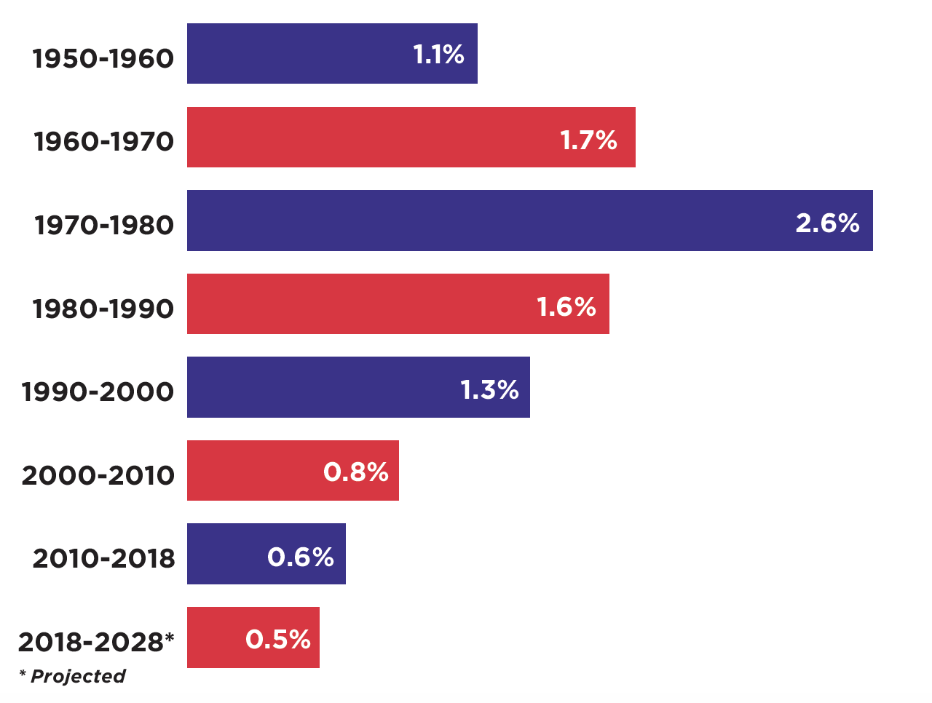
U.S. Civilian Labor Force Growth
National Restaurant Association 2030 report

Slide 8
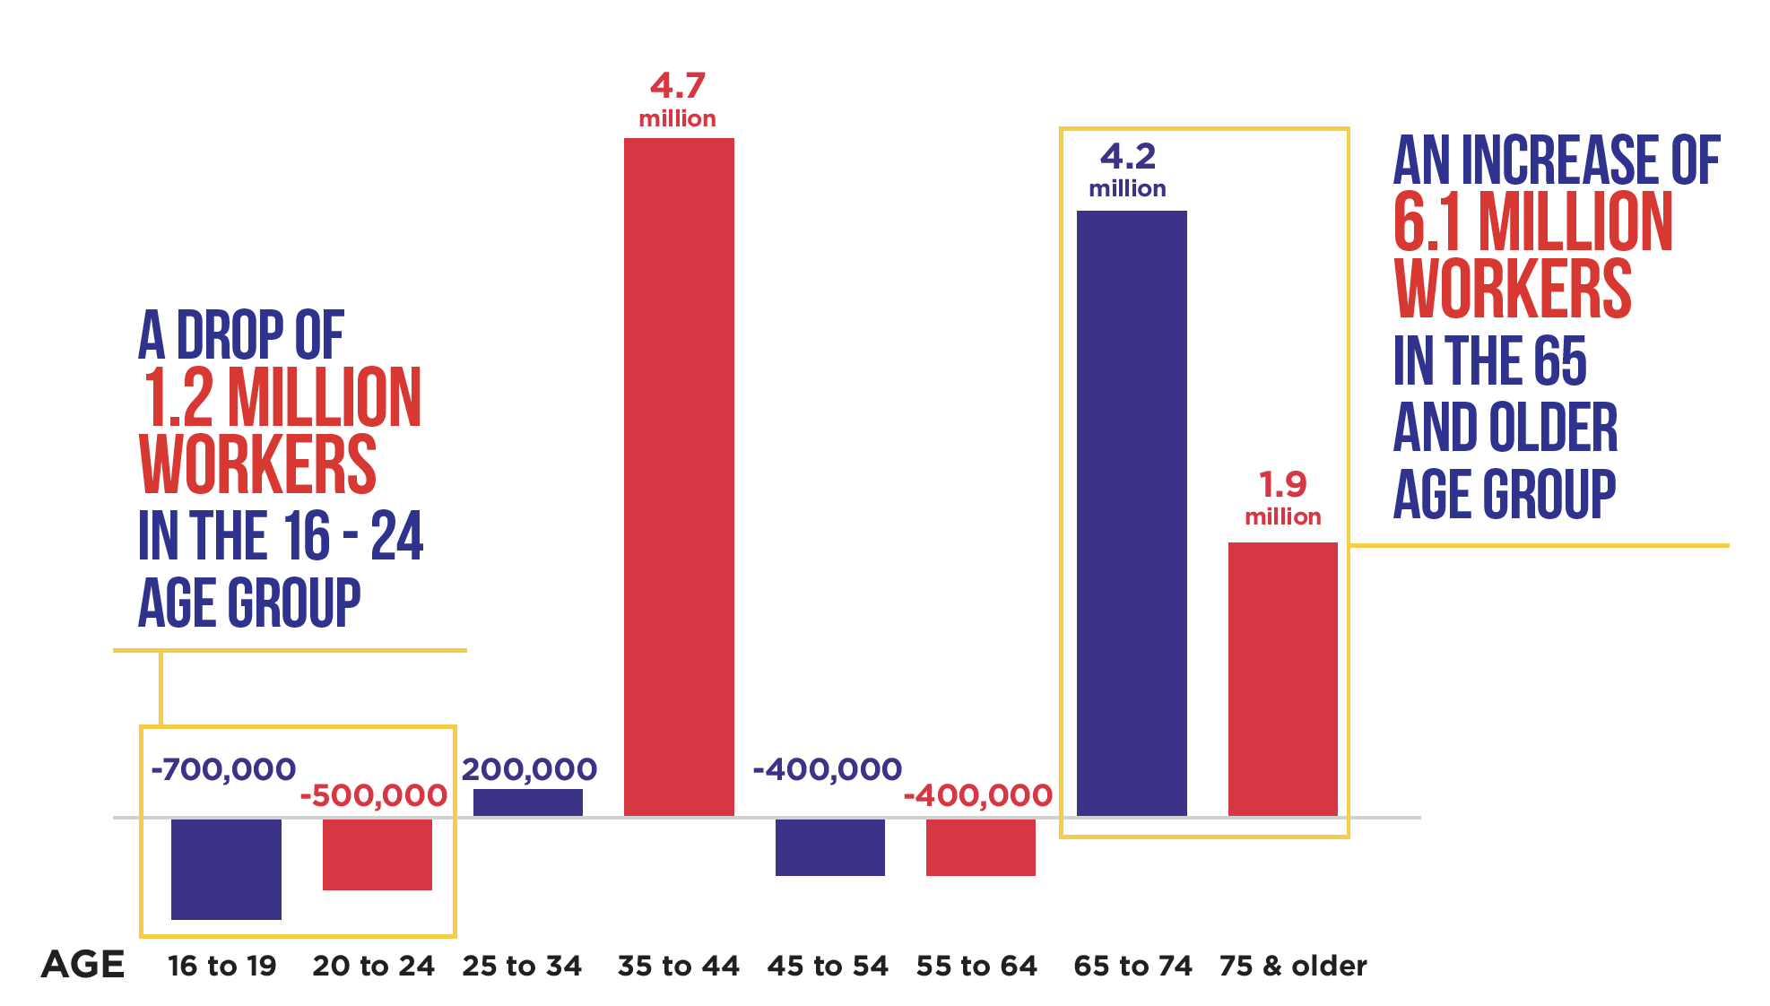
Projected change in the U.S. labor force by age, 2018 to 2028
National Restaurant Association 2030 report

Slide 9
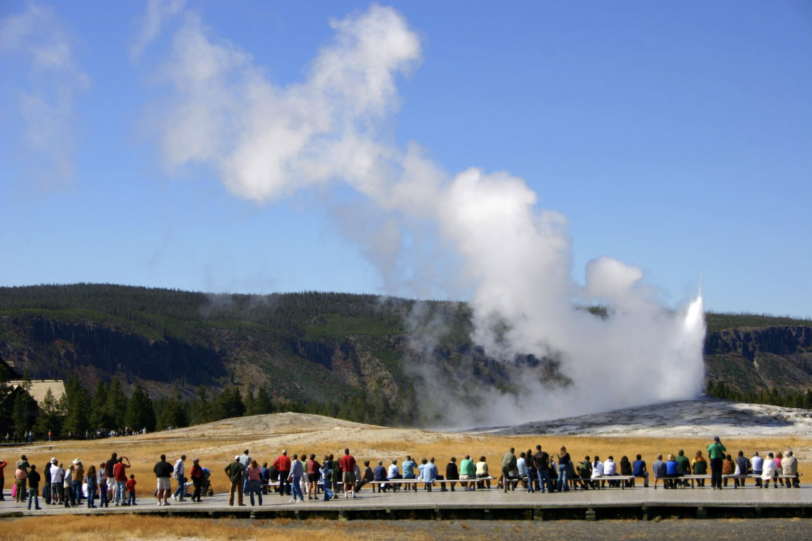
Discussion

Slide 10
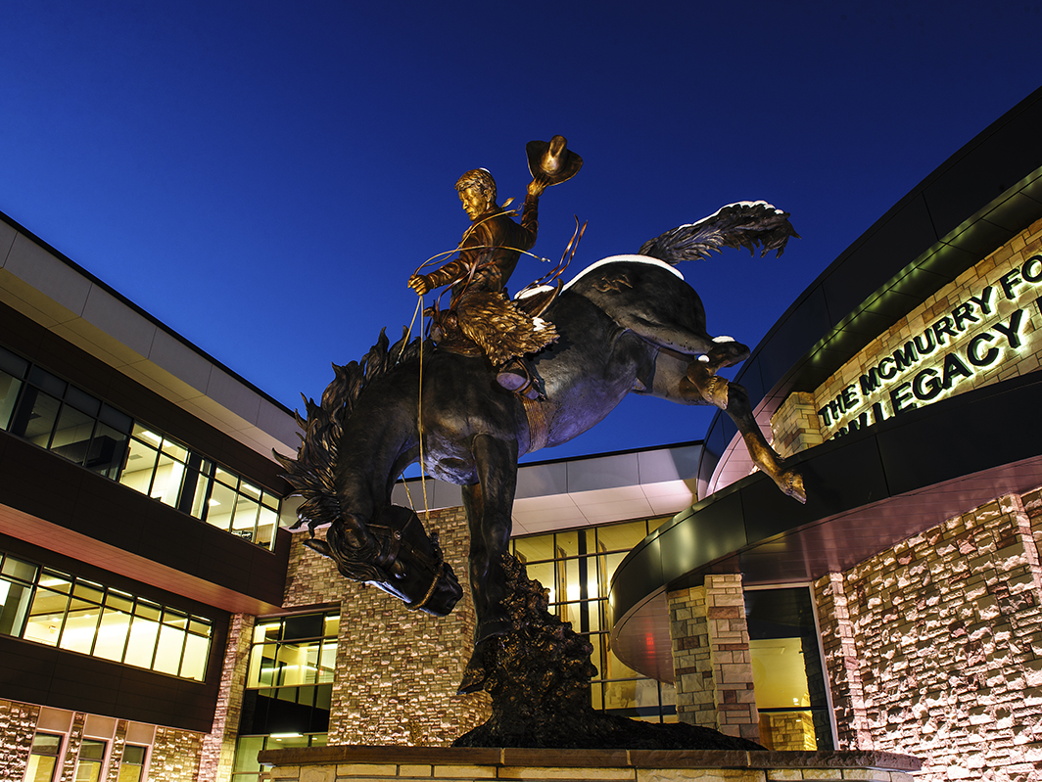
Thank you
Dan McCoy
dan.mccoy@uwyo.edu
Jordan Rebecca Kobliska jkoblisk@uwyo.edu
Amy Madera
amadera@cwc.edu
Molly Matthaei
mmatthaei@tcsd.org

