Slide 1
WHTC Executive Director Chris Brown
2023 Legislative Update and 2024 Election Outlook

Slide 2
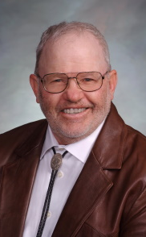
Please welcome Albert Sommers Speaker of the Wyoming House of Representatives
2023-2024 Speaker of the House
2021-2022 House Majority Floor Leader
2019-2020 House Speaker Pro Tempore
2017-2018 House Majority Whip

Slide 3
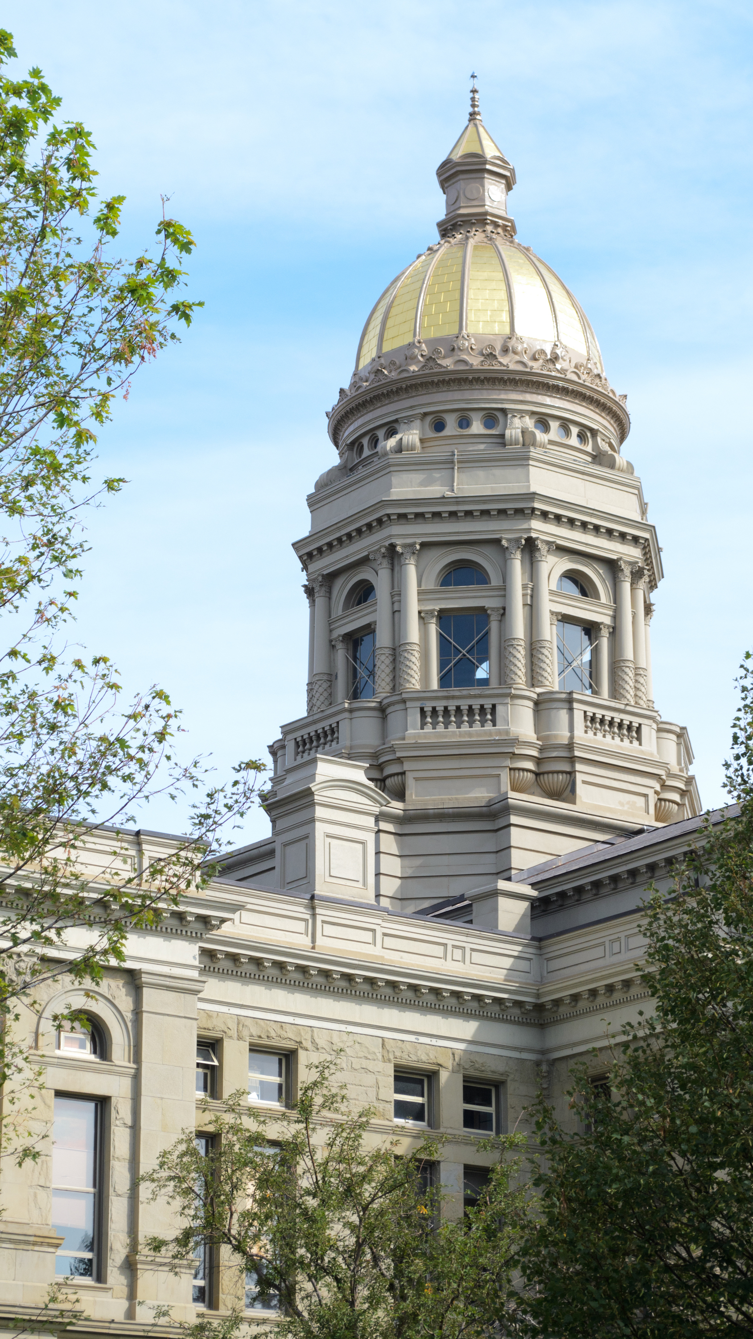
2024 Legislative Budget Session February 12, 2024, to March 8, 2024 (20 working days) 3 days carried over from the 2023 General Session if needed Bills require a 2/3 vote in the House of Origin to be introduced (41 in House, 21 in Senate) The primary focus is the biennium budget Expect ballpark 300 bills
z

Slide 4
WHTC Primary Objective Wyoming Tourism Board Biennium Budget
Total biennium budget $39 million
Make $8.8 million one-time funding part of standard budget.
Add full-time Data Analyst and Industry Development Manager to the Wyoming Office of Tourism staff.
Talking points sheets will be available on WHTC website in November
Be prepared to defend on 2nd and 3rd reading

Slide 5
Other issues
Outdoor Recreation, Tourism Trust Fund
Travel, Recreation, Wildlife, Cultural Resources Committee Bill
Account established last session. Governance of account being considered
$3 million annually from Special Project/Reserve Acct until the account hits $250MM
Projects over $250,000 will be vetted by an oversight committee and considered by the legislature in an omnibus bill.
Shooting Sports Complex
Task Force has been meeting
Initial inquiry to communities sent out. Formal RFP to follow later
Focus is a world-class facility

Slide 6
Federal issues
Per Diem Rates Increased.
H2B Work
Credit Card Competition Act

Slide 7
Calls To Action
Has been a few years since an industry-wide call to action
Used sparingly
Require immediate action
Includes easy-to-follow instructions
Critically important! Your voice is THE most important!

Slide 8
The 2024 Election is critically important for our industry!
16 Senators (half) up for reelection
62 Representatives (all) up for reelection
We need pro-tourism and pro-business candidates to run!
Only a handful of votes away in both chambers from serious threat.

Slide 9
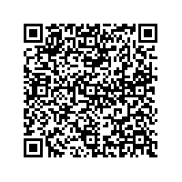
WHTC PAC-Donate Today!
Please consider donating to the Wyoming Hospitality and Travel Coalition PAC. Every single dollar donated will go toward candidates that support hospitality and tourism in Wyoming.
Please note- ONLY PERSONAL FUNDS MAY BE DONATED. NO CORPORATE FUNDS ARE ABLE TO BE ACCEPTED.
Thank you very much for your support.

Slide 10
Thank you! Chris Brown Executive Director chris@wyohtc.org
z

