Slide 2
What’s New on Google Travel & Beyond

Slide 3
Kim Palmer
Program Director, Destination Optimization

Slide 4
Generational Differences in Travel Inspiration
Biggest generational differences ever recorded since research commenced in 2008.
For those under 40, a radical shift to focus on images and short-format video content
Future Partners: State of the American Traveler

Slide 5
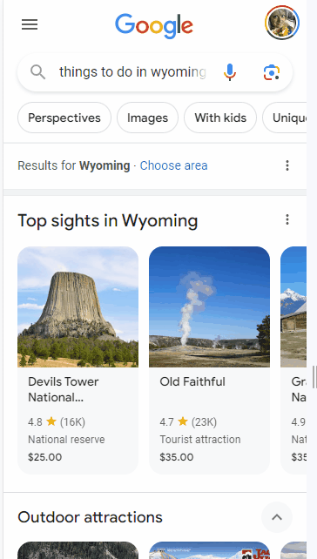
Today’s Google Travel Search Results
Primarily Mobile
More Visual + More Video
More Transactional

Slide 6
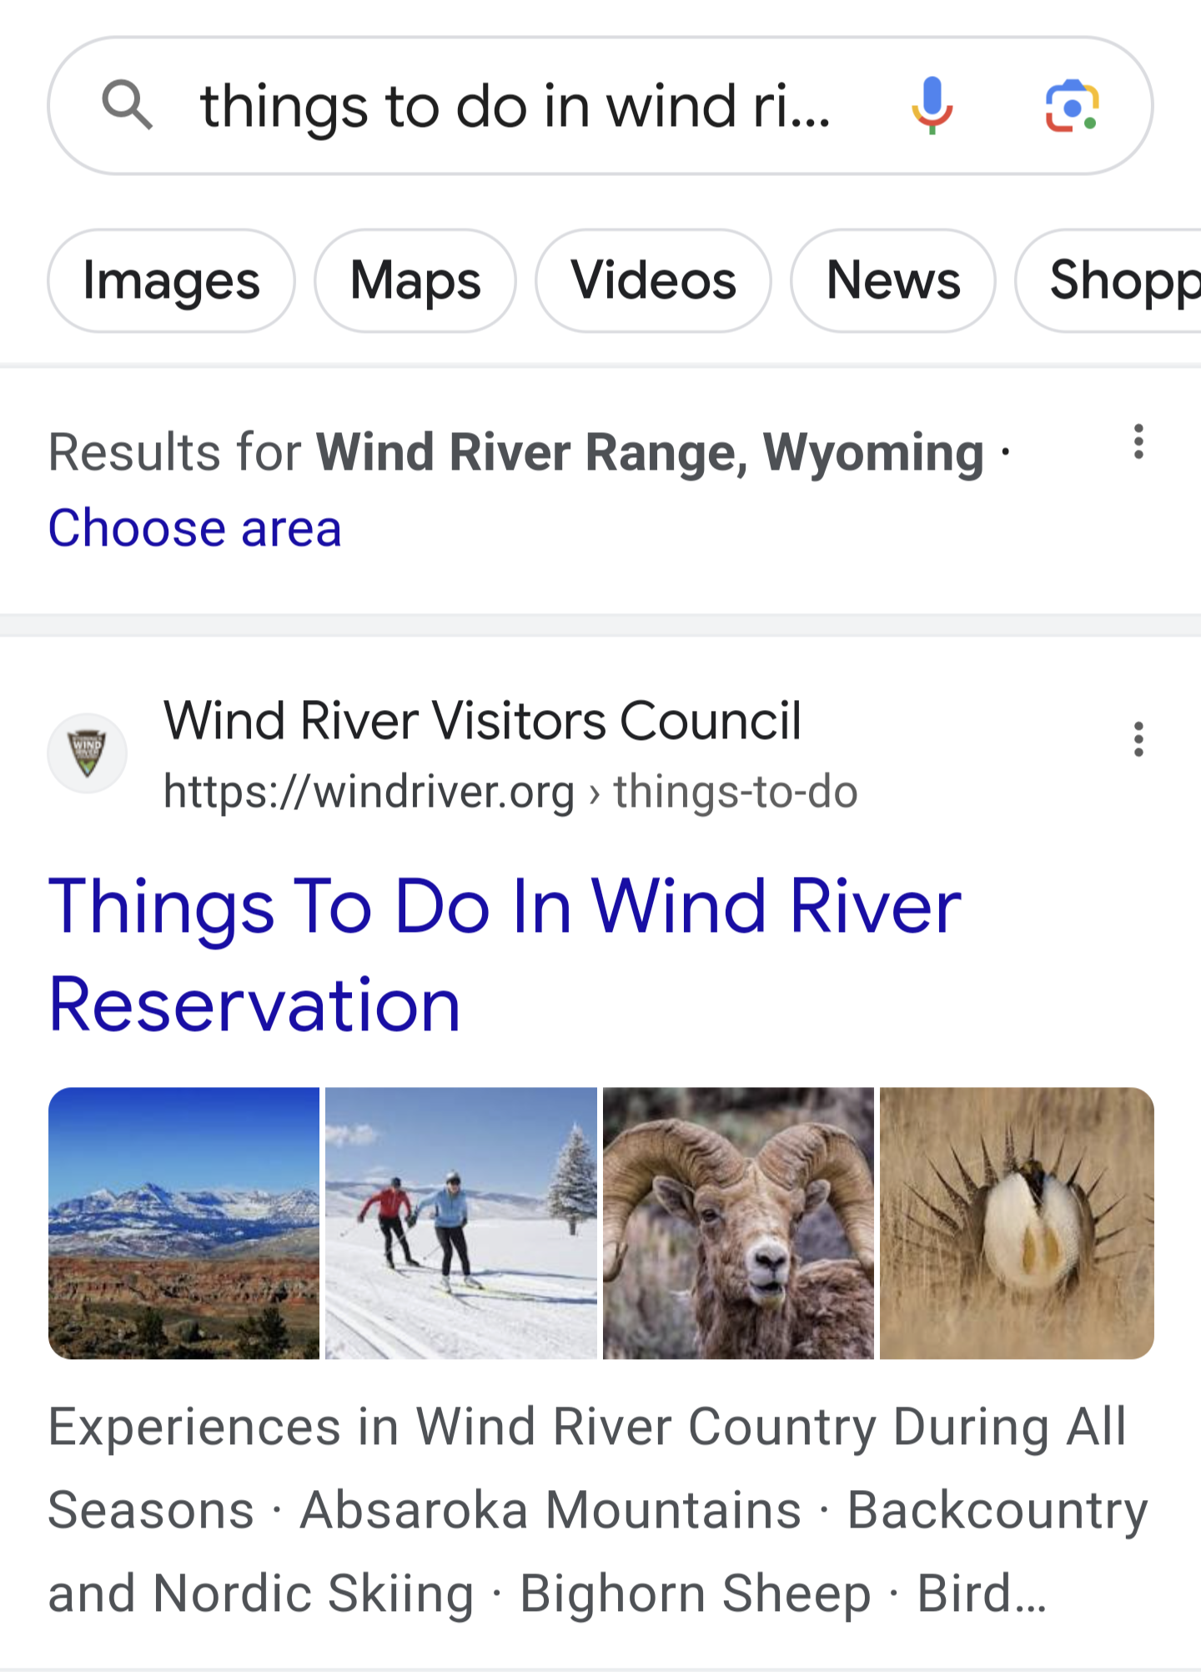
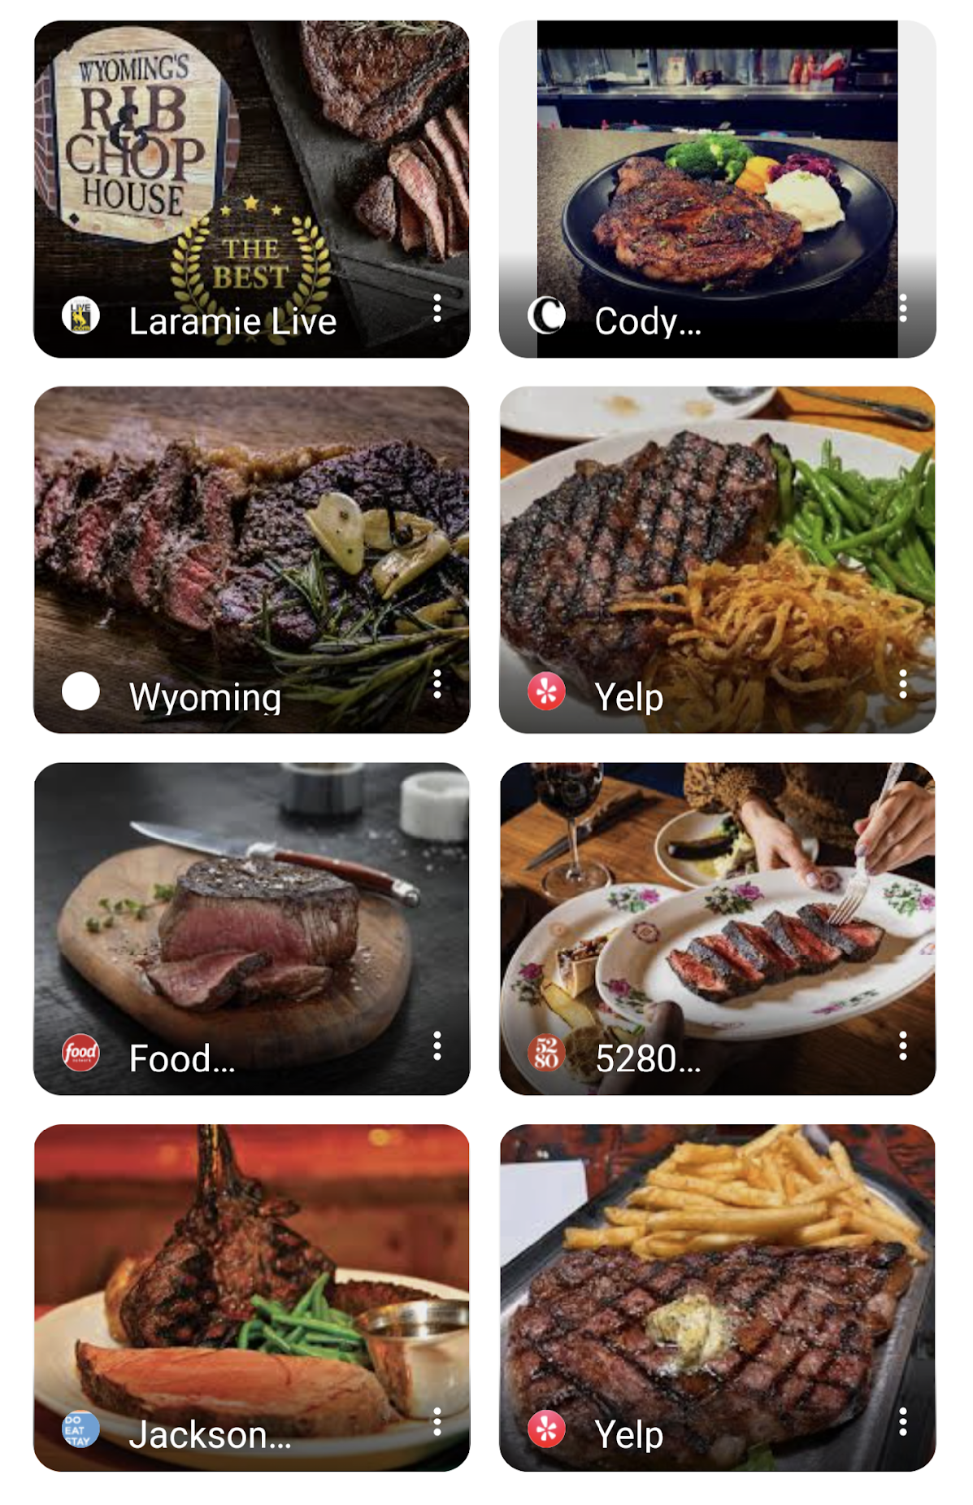
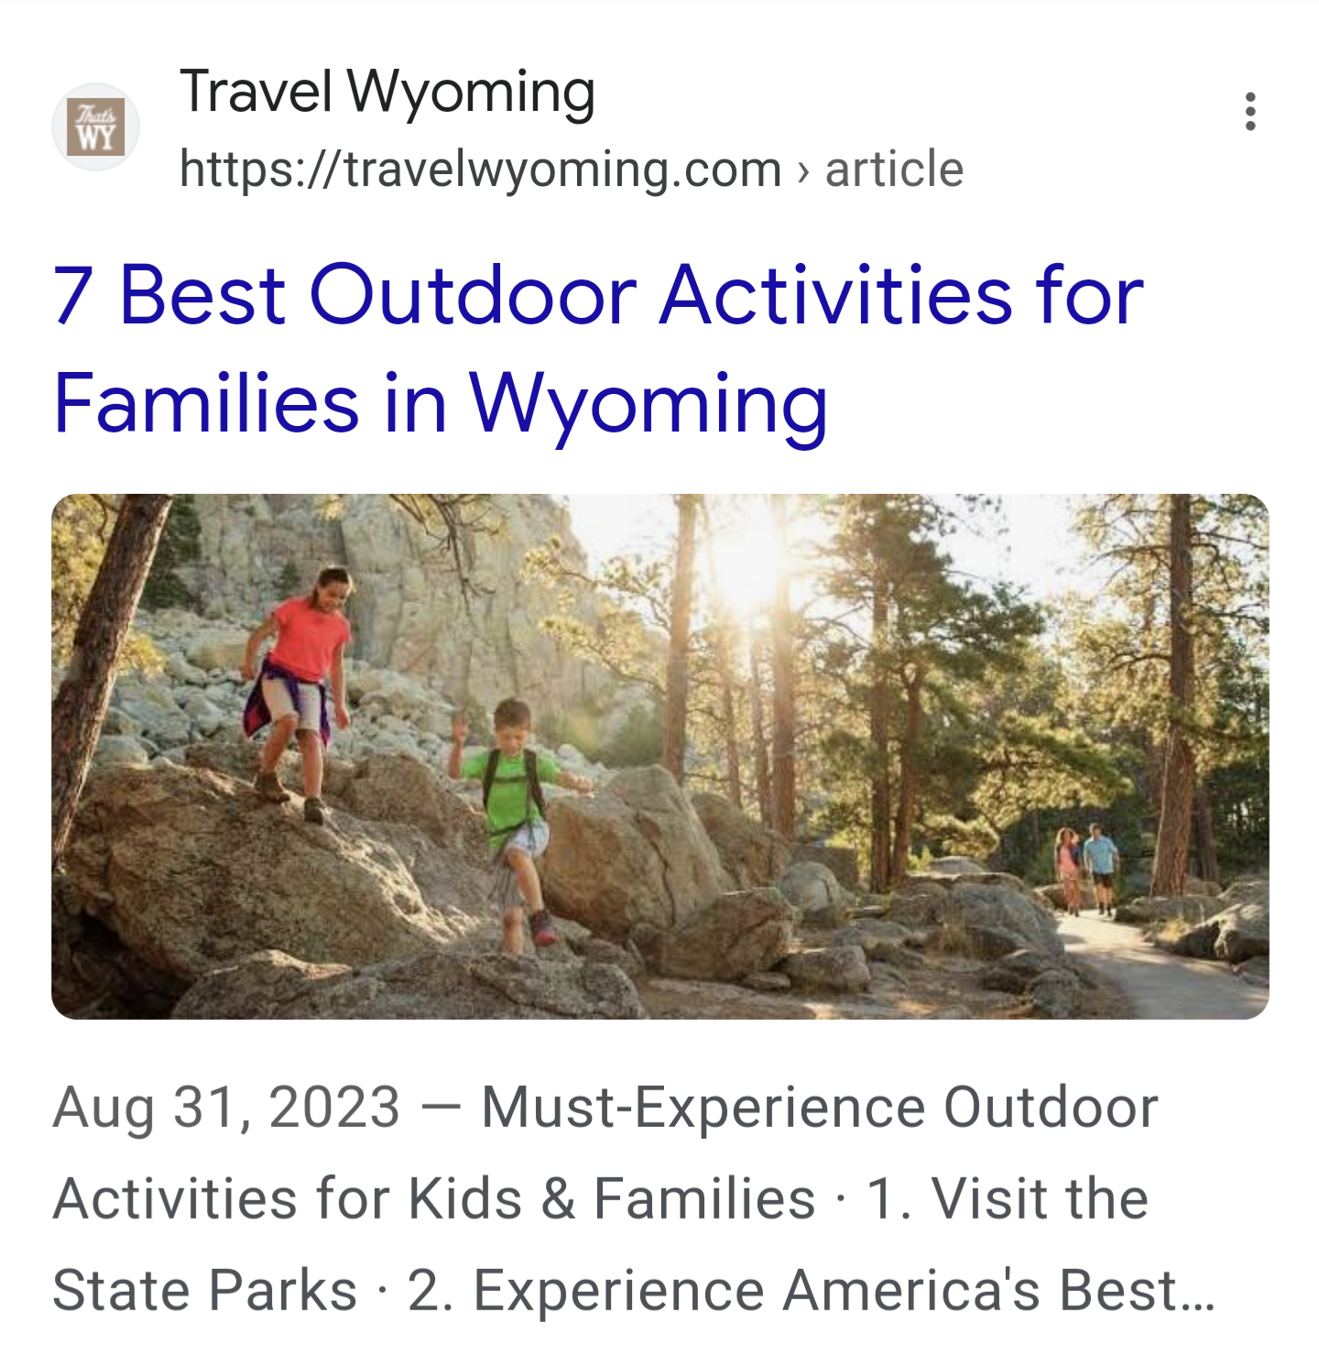
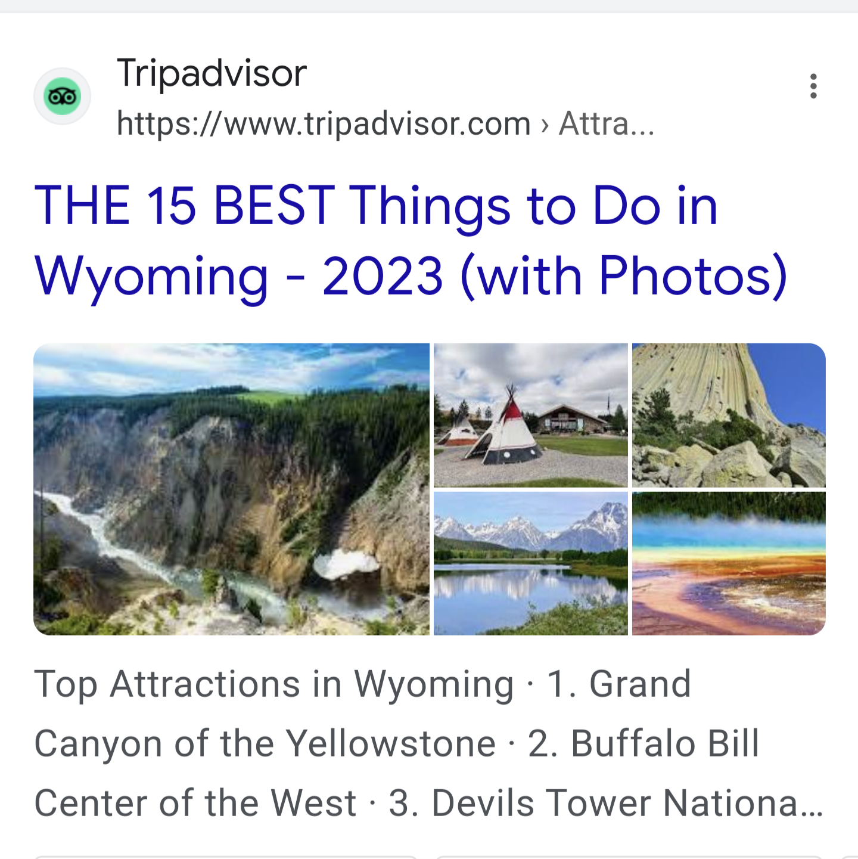
More Visual Results

Slide 7
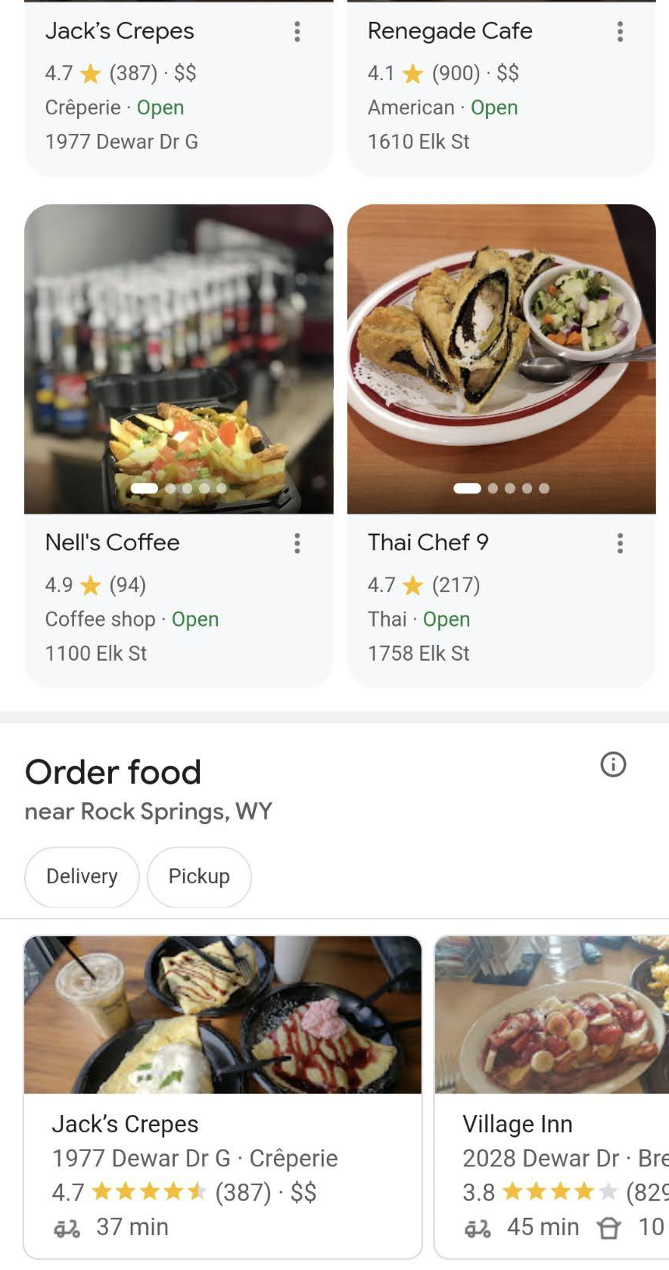
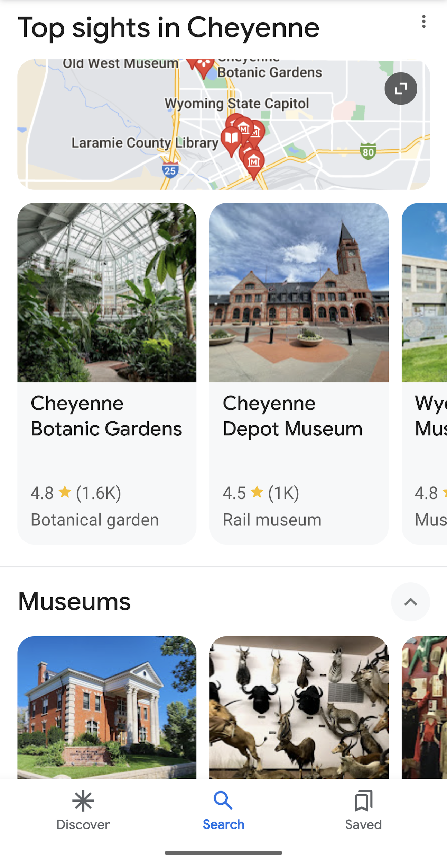
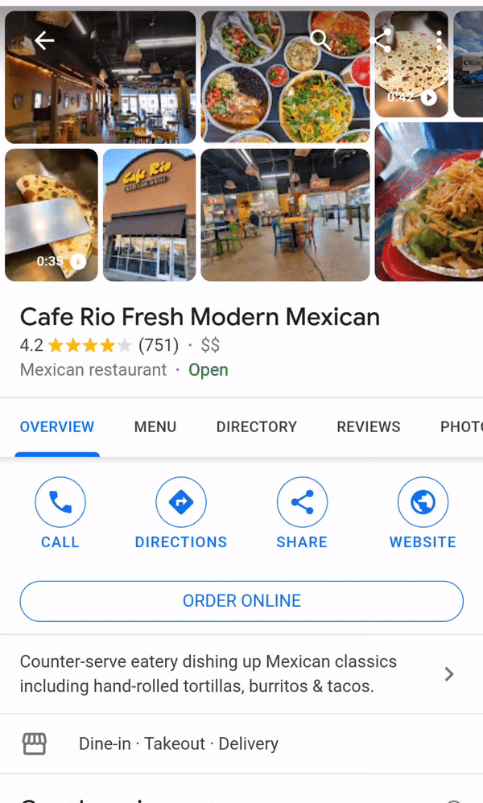
More Visual Results

Slide 8
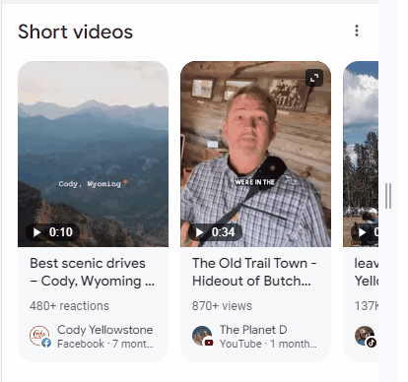
Short Form Video Results
Visible on mobile only
Destination & Things to Do Searches
Sources include YouTube Shorts, TikTok, Facebook
Expect expansion in to dining

Slide 9
YouTube Shorts Best Practices
:60 or less only
Capture attention early
Feature one message clearly
Use hashtags and reference your destination in titles
Cross promote long-form content on your channel

Slide 10
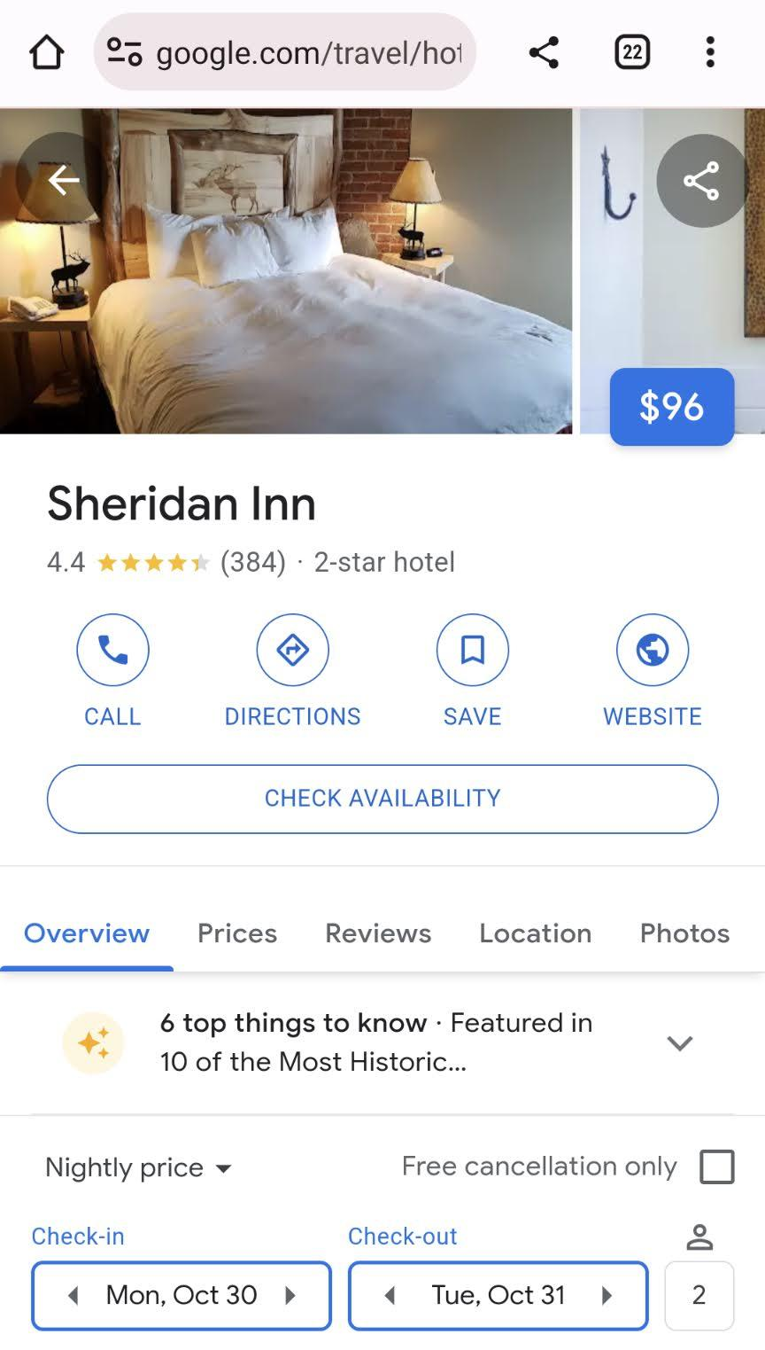
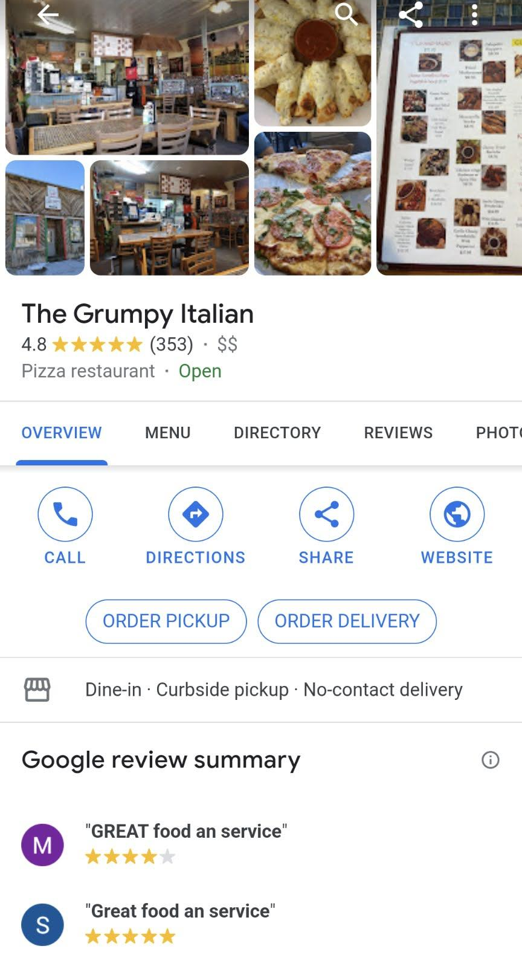
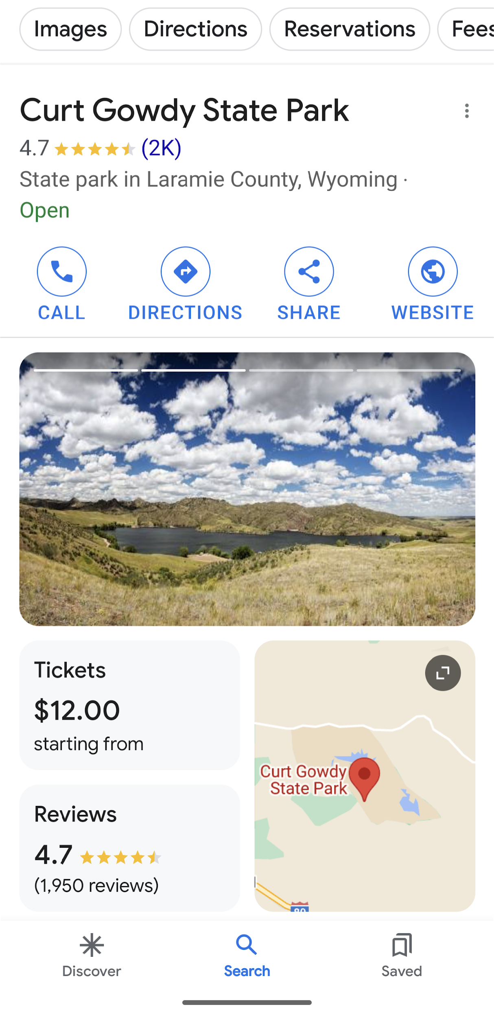
Greater Emphasis on Conversion

Slide 11
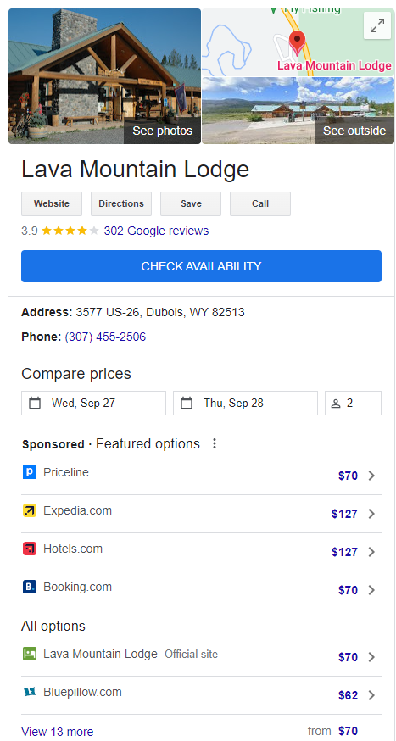
Free Booking Link
With a verified listing, lodging providers don’t have to rely on third party sites for bookings.
Instead, you can add a free booking link that will take travelers to your website to book directly.

Slide 12
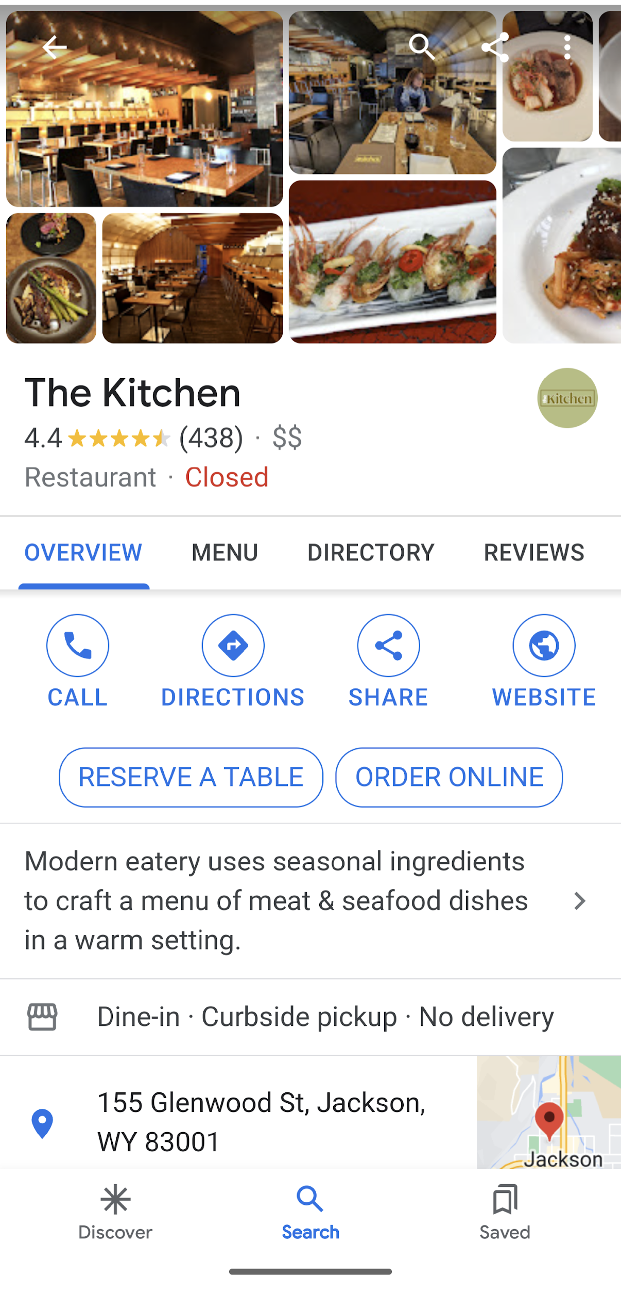
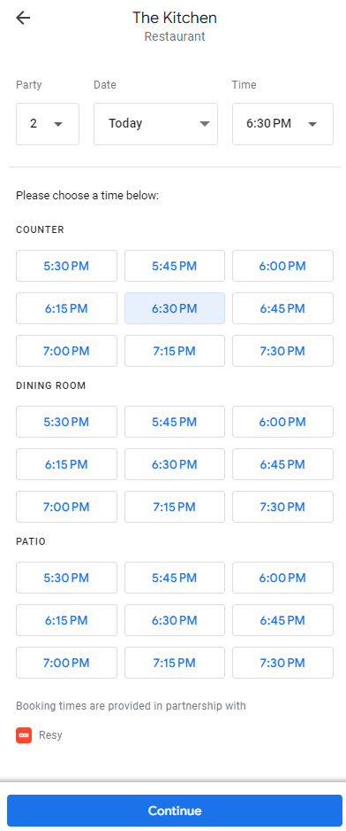
Integrations for Restaurants
Connect with Open Table or Resy
Provide links to online ordering, whether through your own site or third parties

Slide 13
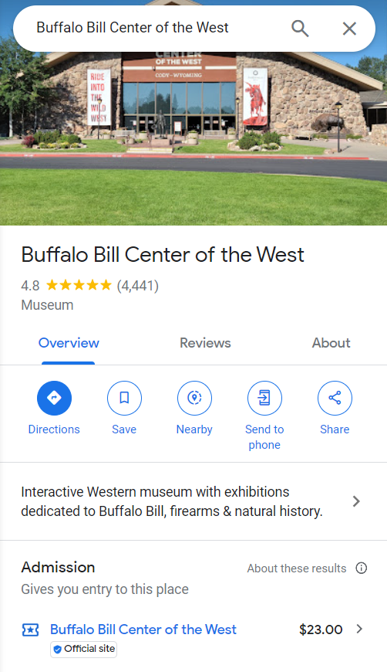
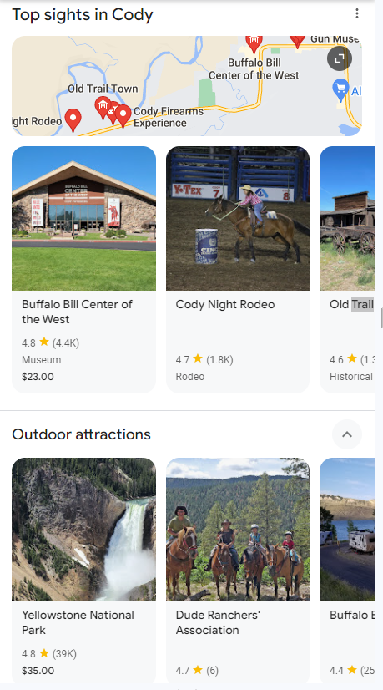
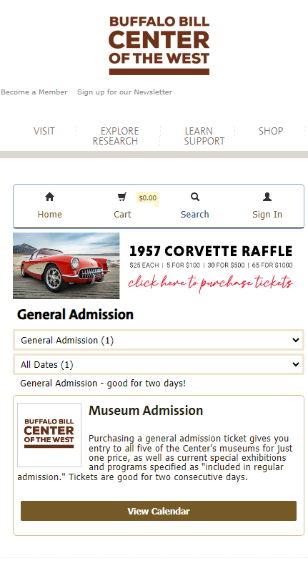
Attraction Tickets
Link directly to your online booking page
Must be for general admission tickets, not tours
Other suppliers may appear, but Official Tickets are given preference in ranking

Slide 14
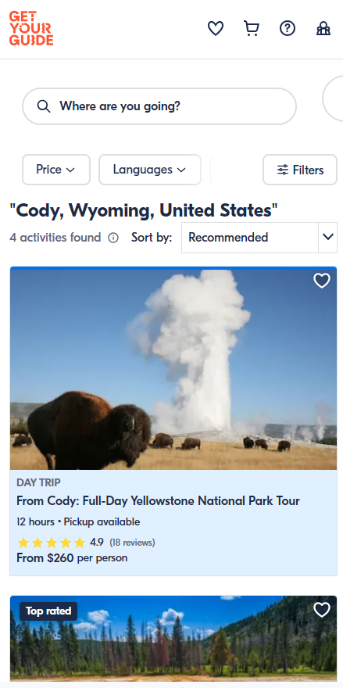
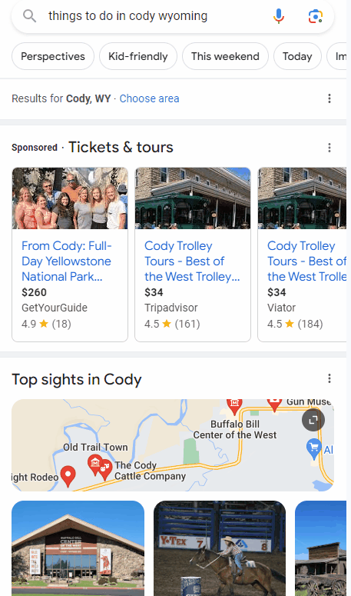
Tickets & Tours Ad Unit
Appears in destination & “things to do” searches in markets with critical mass of tours available
PPC ad unit primarily featuring Viatour, Get Your Guide, Groupon and other major aggregators

Slide 15
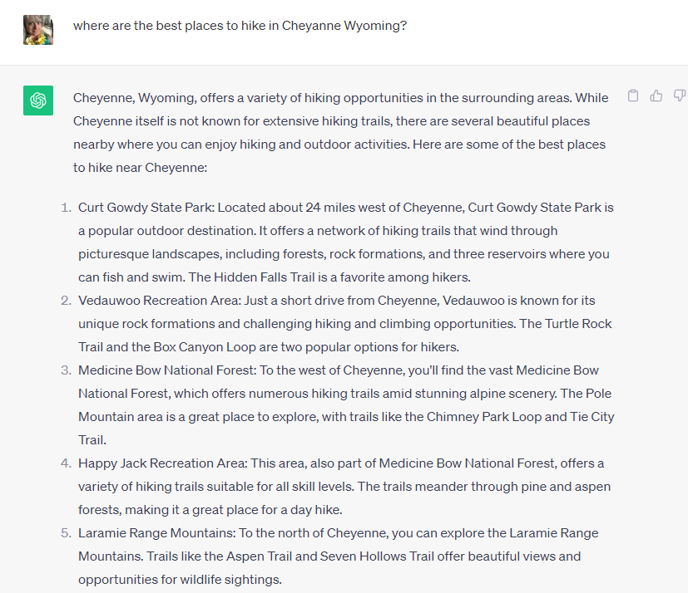
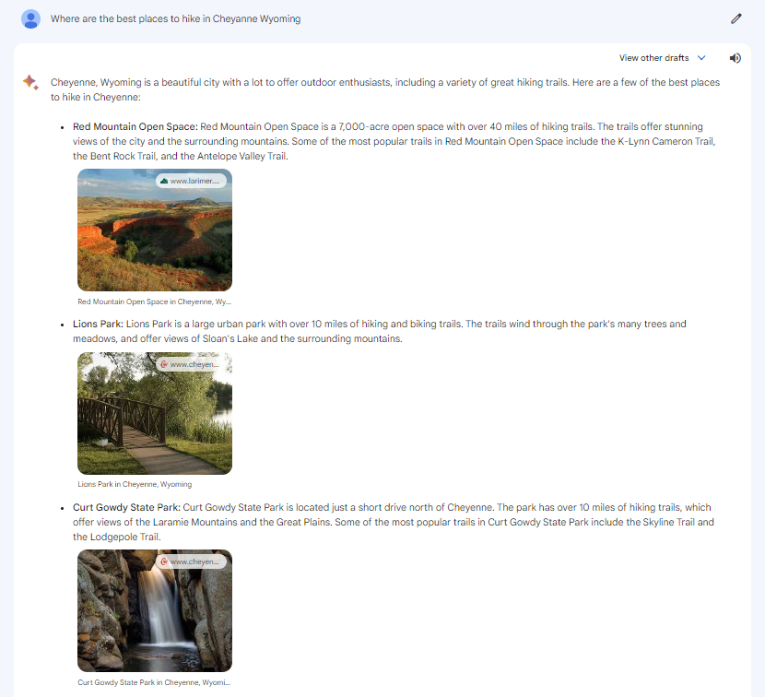
Chatbots Are Changing Search

Slide 16
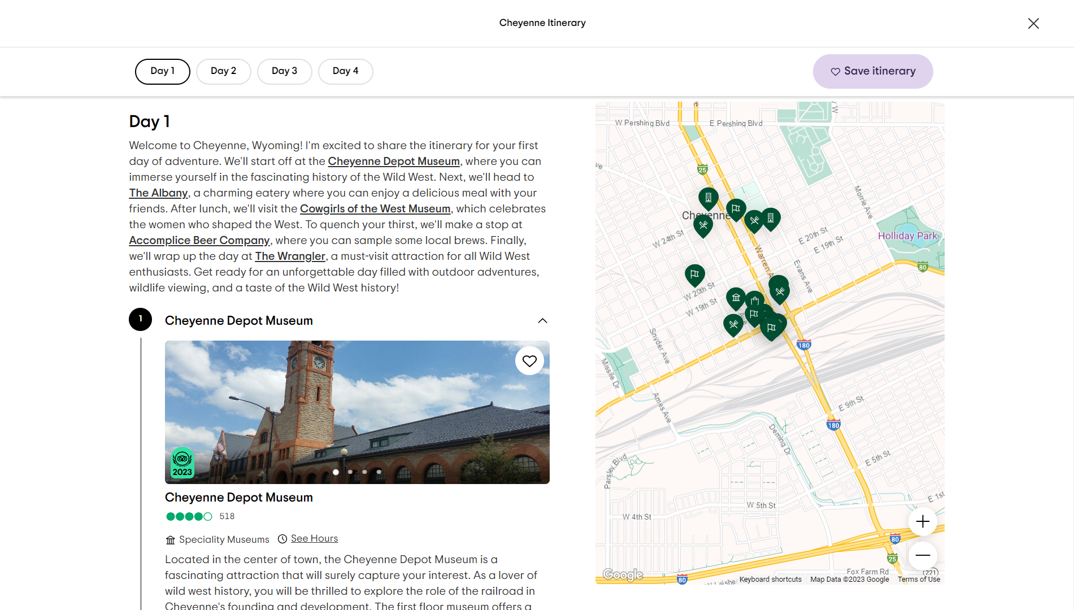
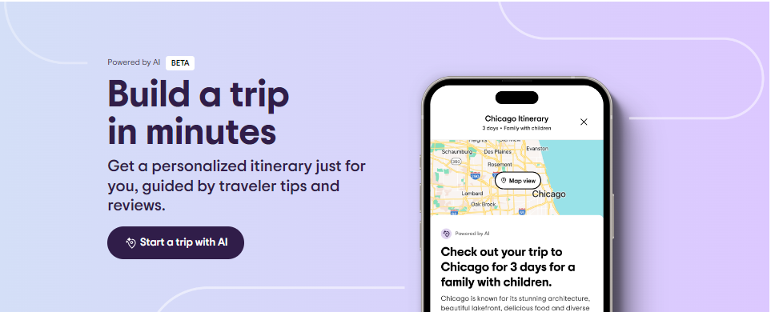
TripAdvisor Launches AI Itineraries

Slide 17
Google’s Search Generative Experience (SGE)
“If you ask detailed questions about a place or destination in Search, you’ll see an AI-powered snapshot that brings together the most helpful information available — not only from across the web, but also from the reviews, photos and Business Profile details”

Slide 18
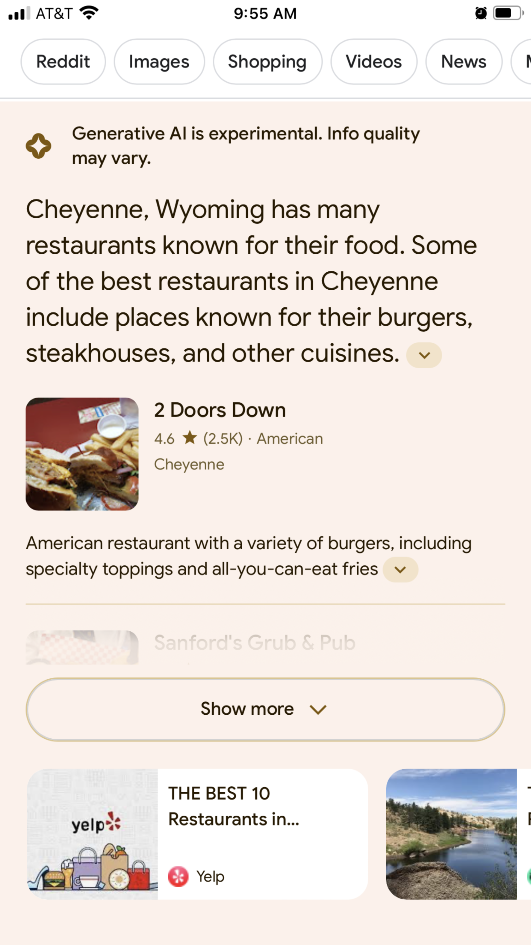
Help Large Language Models Find You
Focus on what users want to know about your destination or business
Prioritize on images, reviews, products, schema, and Google Business Profile categories
Saturate all Google properties: images, web stories, recipes, videos, maps, and events
Short video is also increasingly crucial
Helpful and relevant localized
Source: Search Engine Land

Slide 19
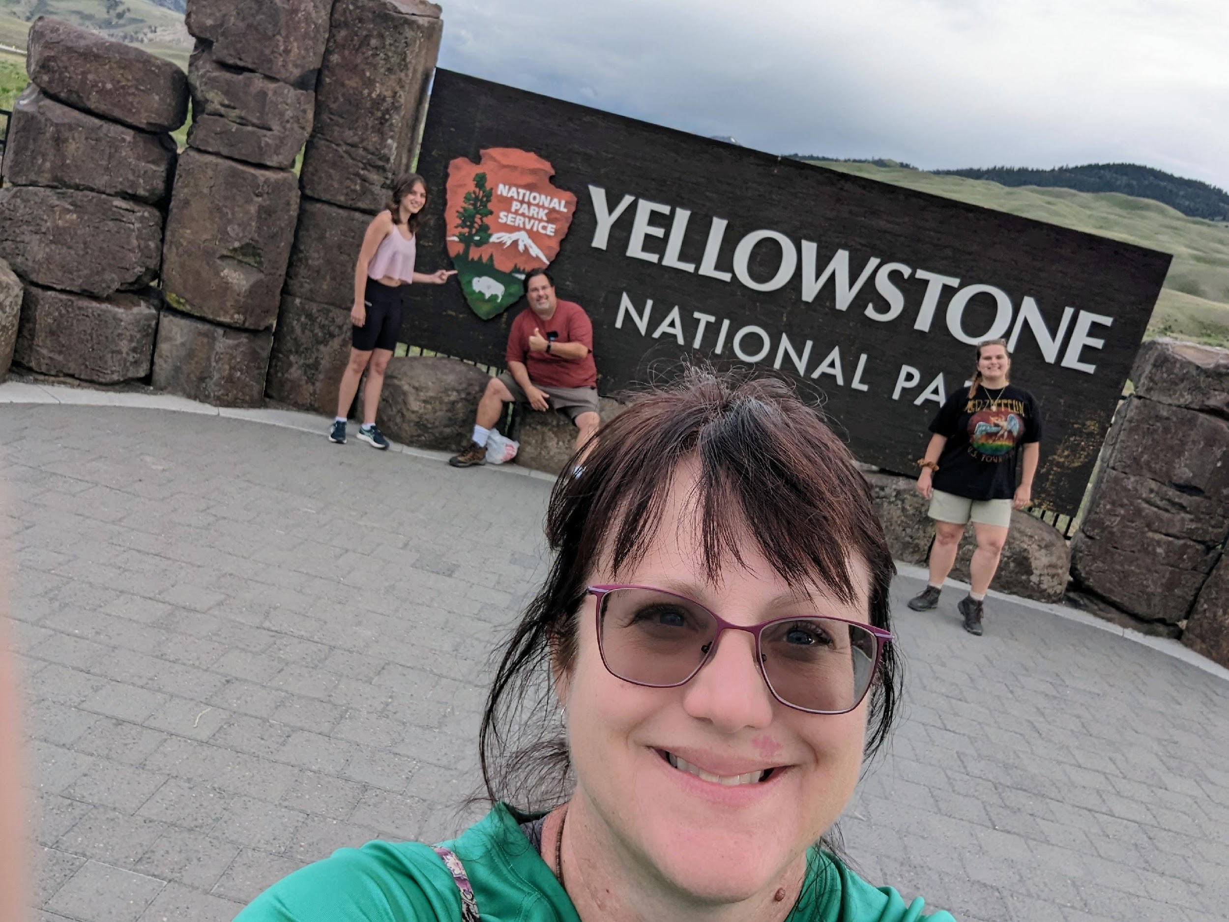
What’s New on Google Travel & Beyond
THANK YOU!

