Slide 1
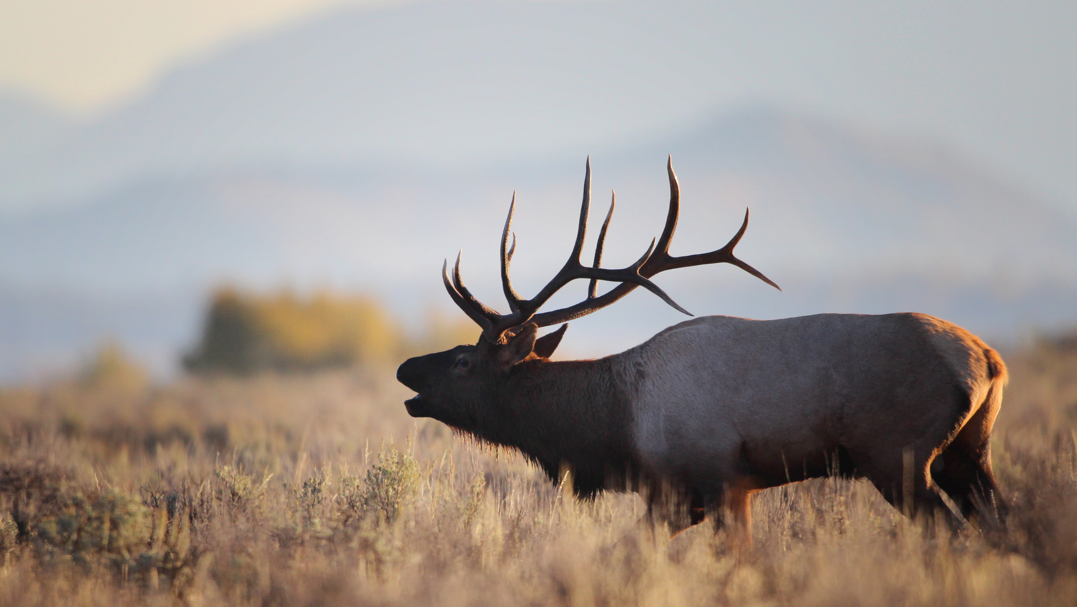
Chris McBarnes
President
Taylor Phillips
Director of the Board
Founder, WYldlife For Tomorrow

Slide 2

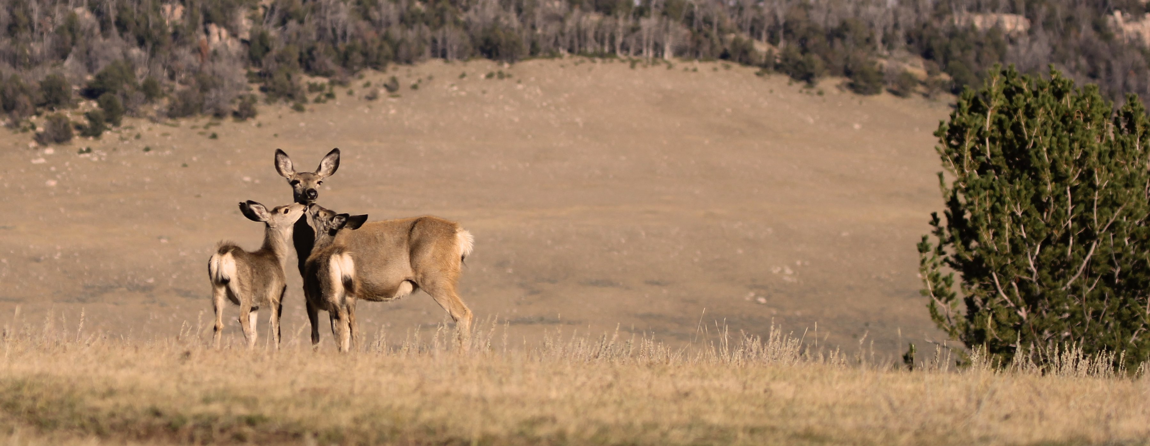
Preview
Who is The WYldlife Fund
Areas of Focus
WYldlife For Tomorrow

Slide 3
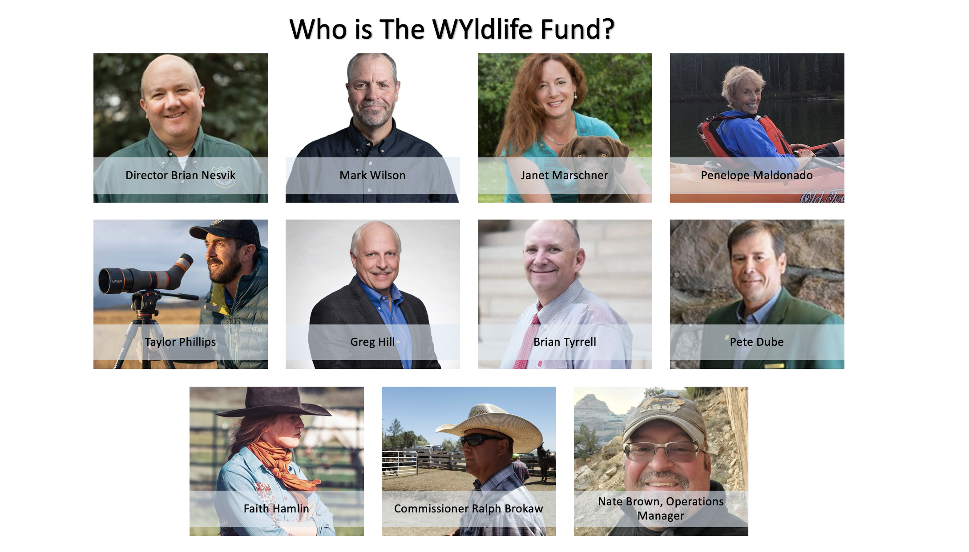

Slide 4
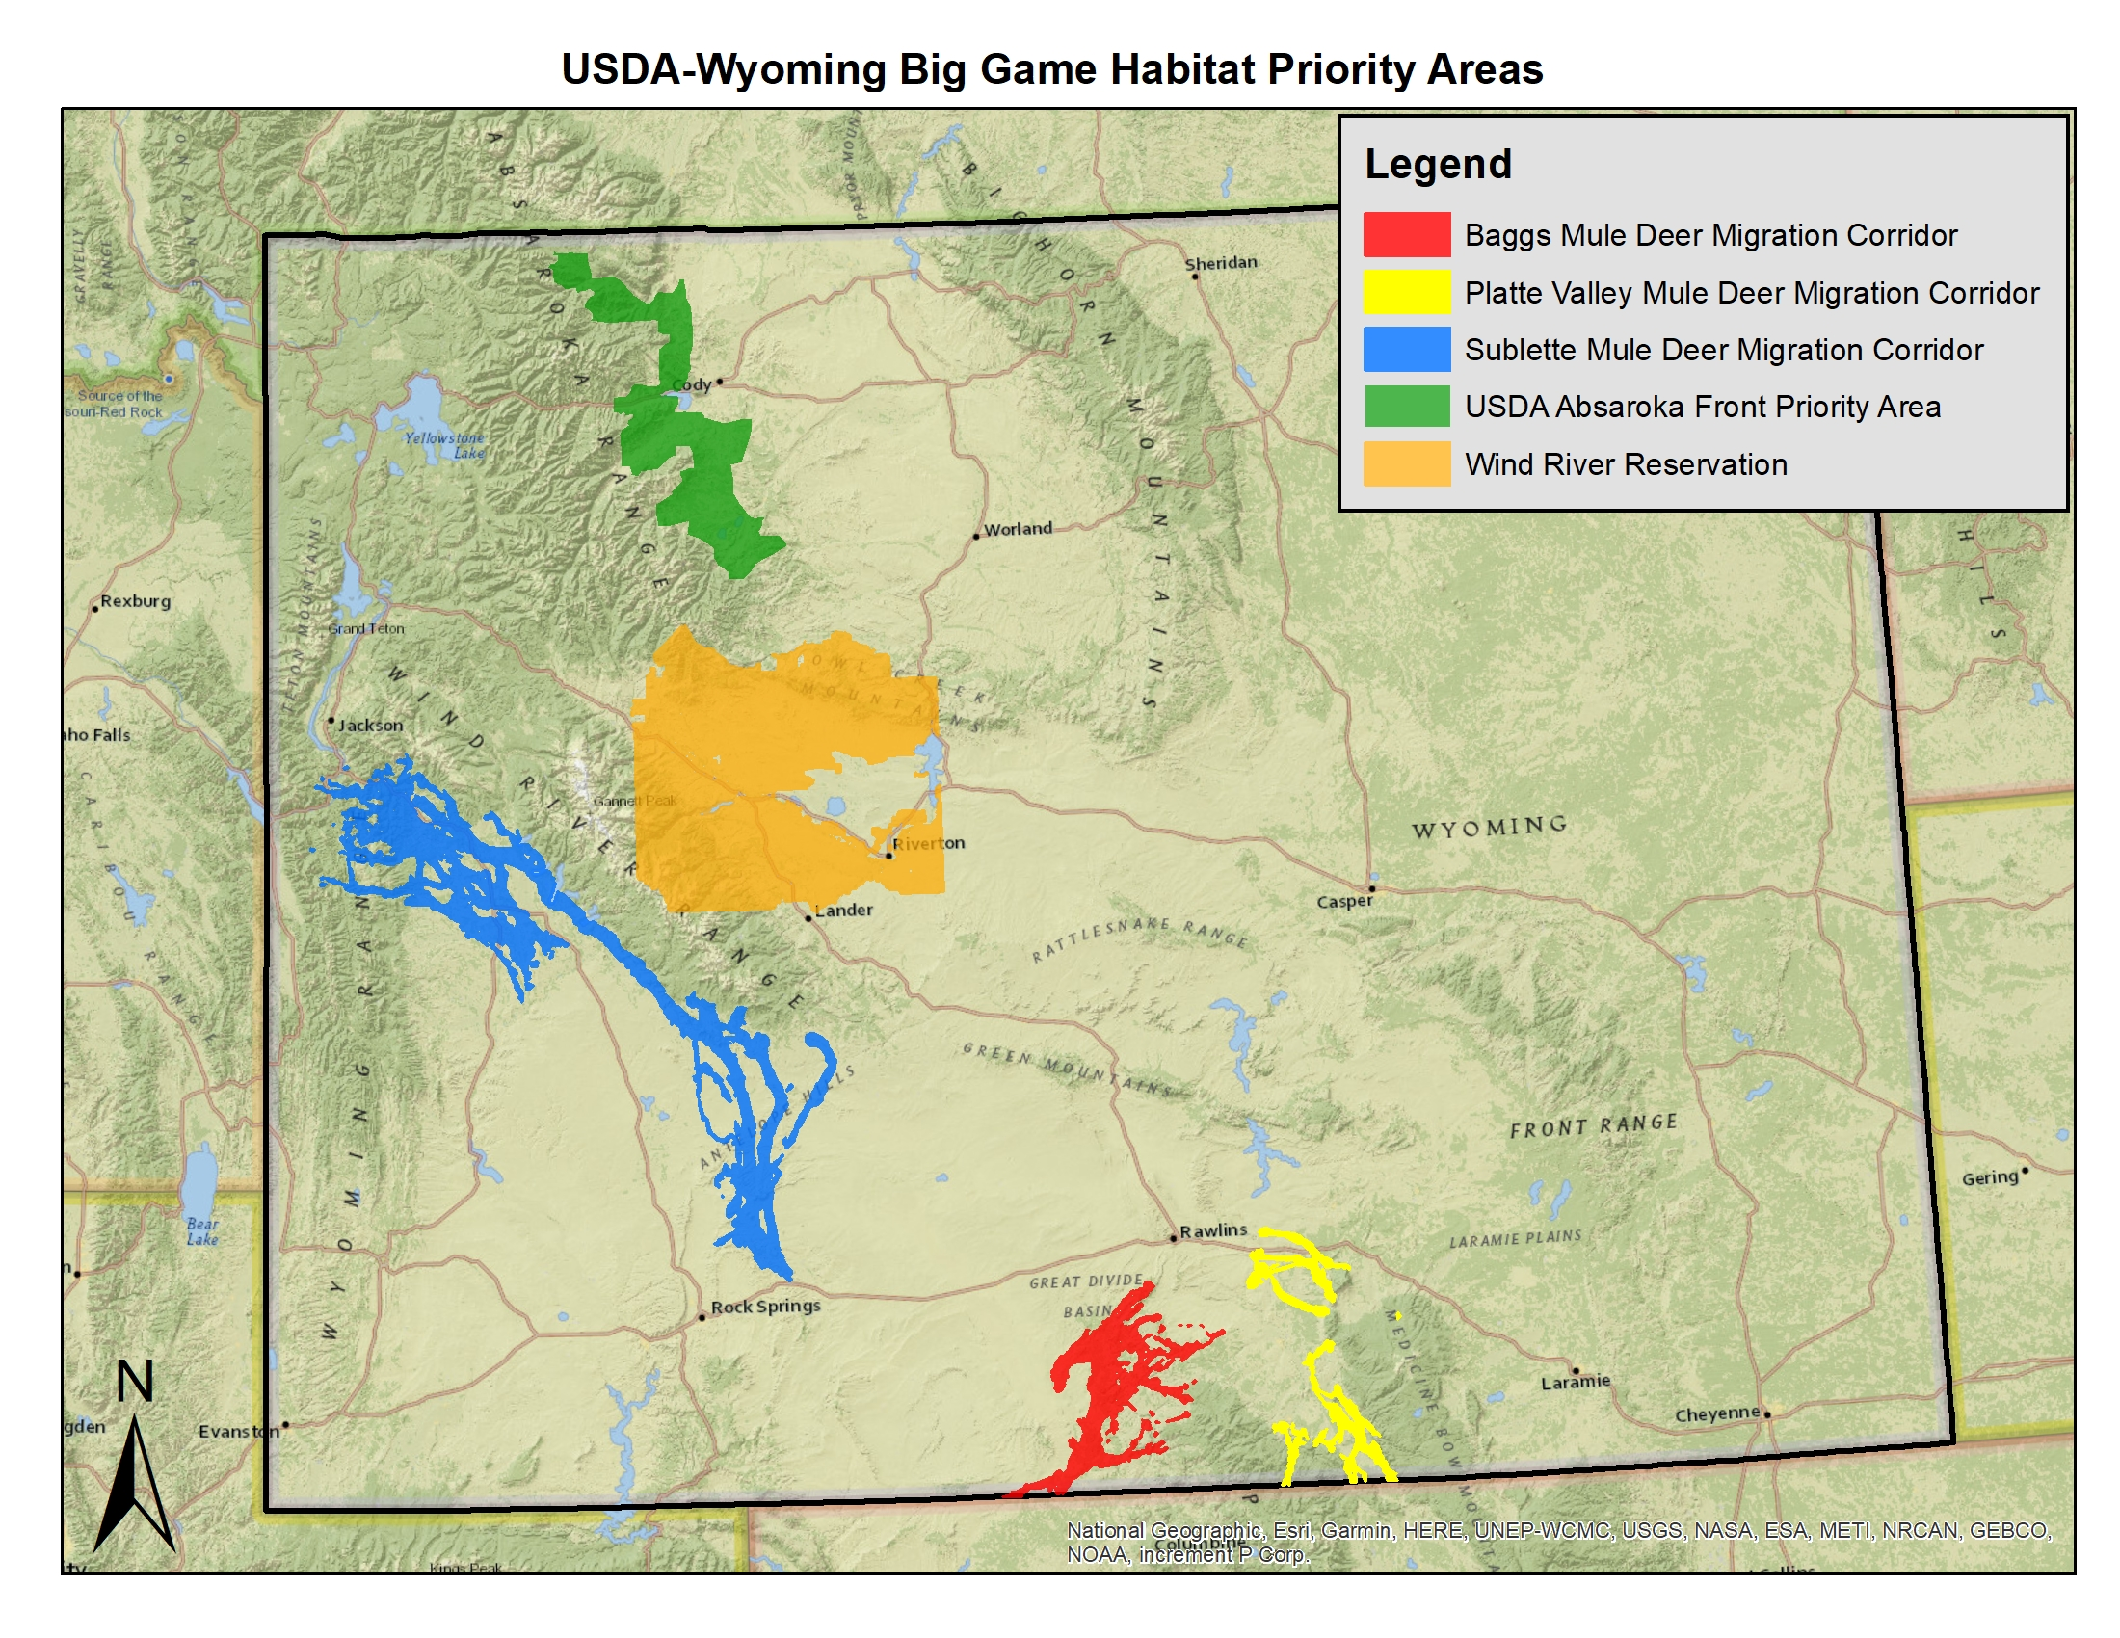
Focus on big game migration and connectivity

Slide 5

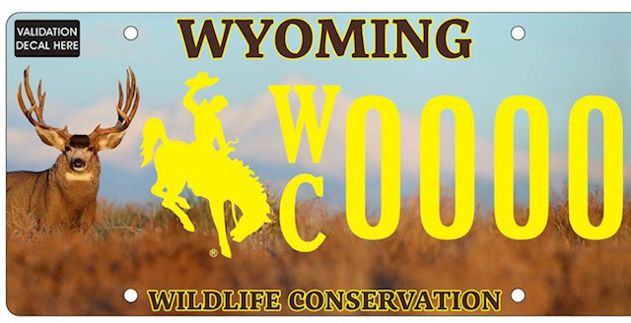
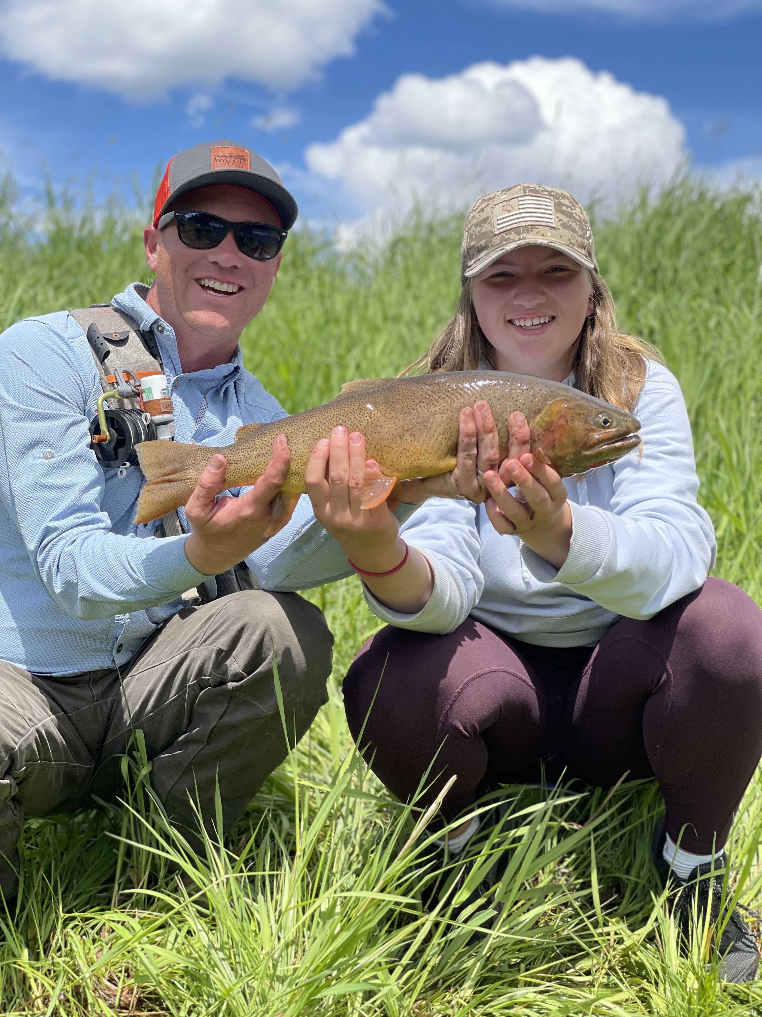
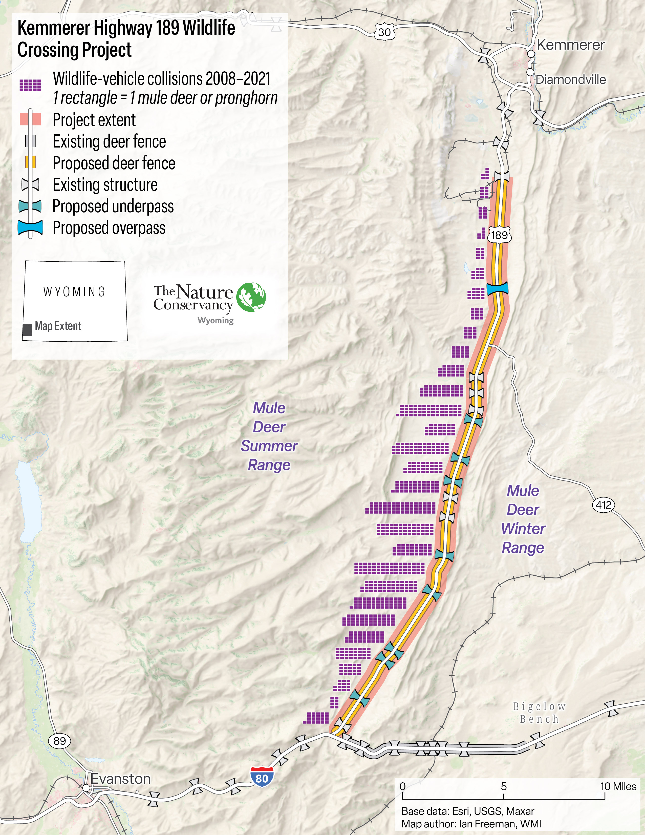

Slide 6
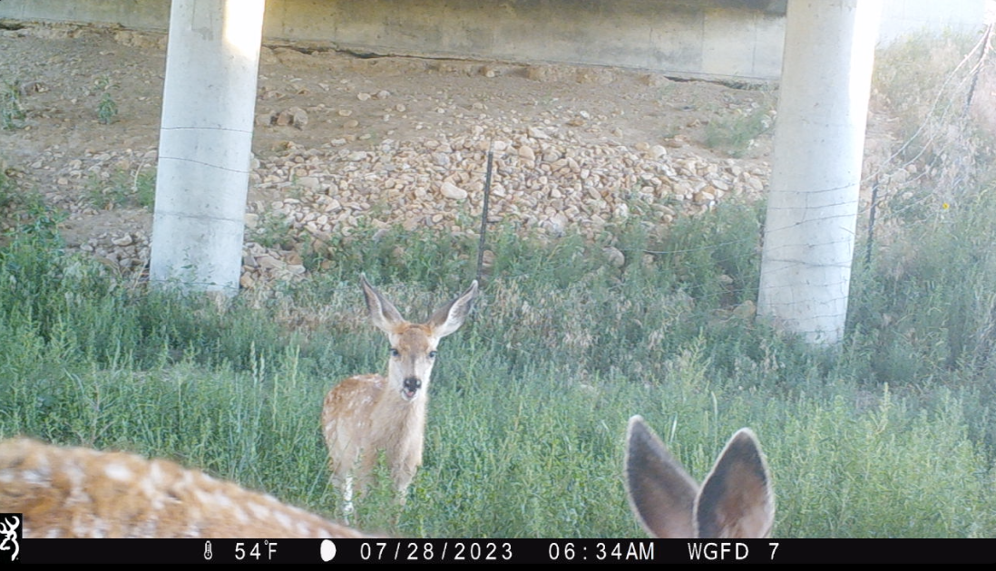

Slide 7
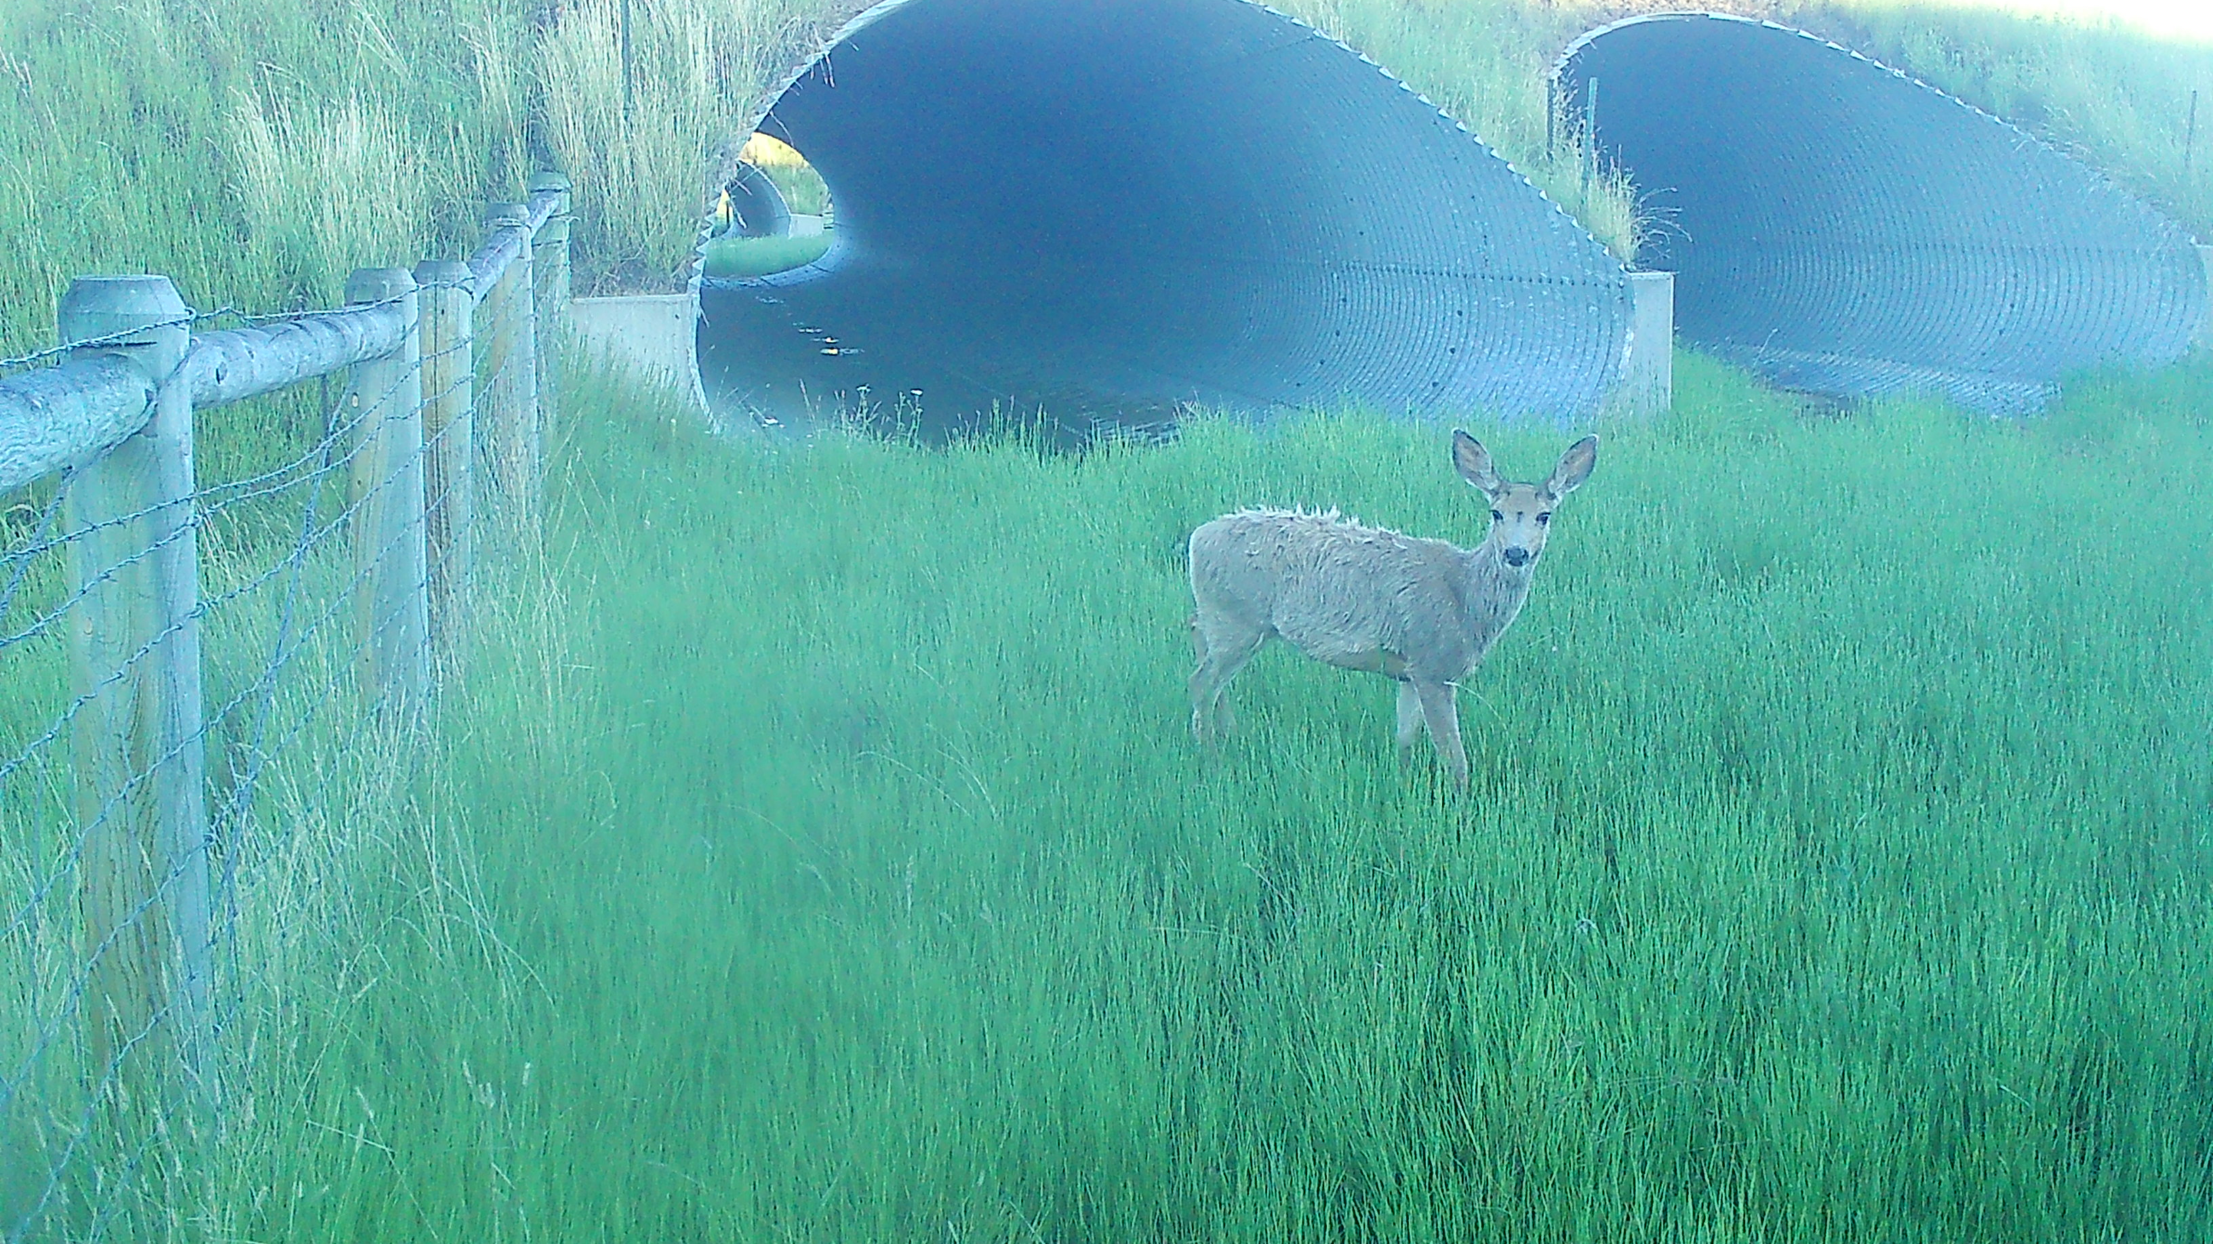

Slide 8
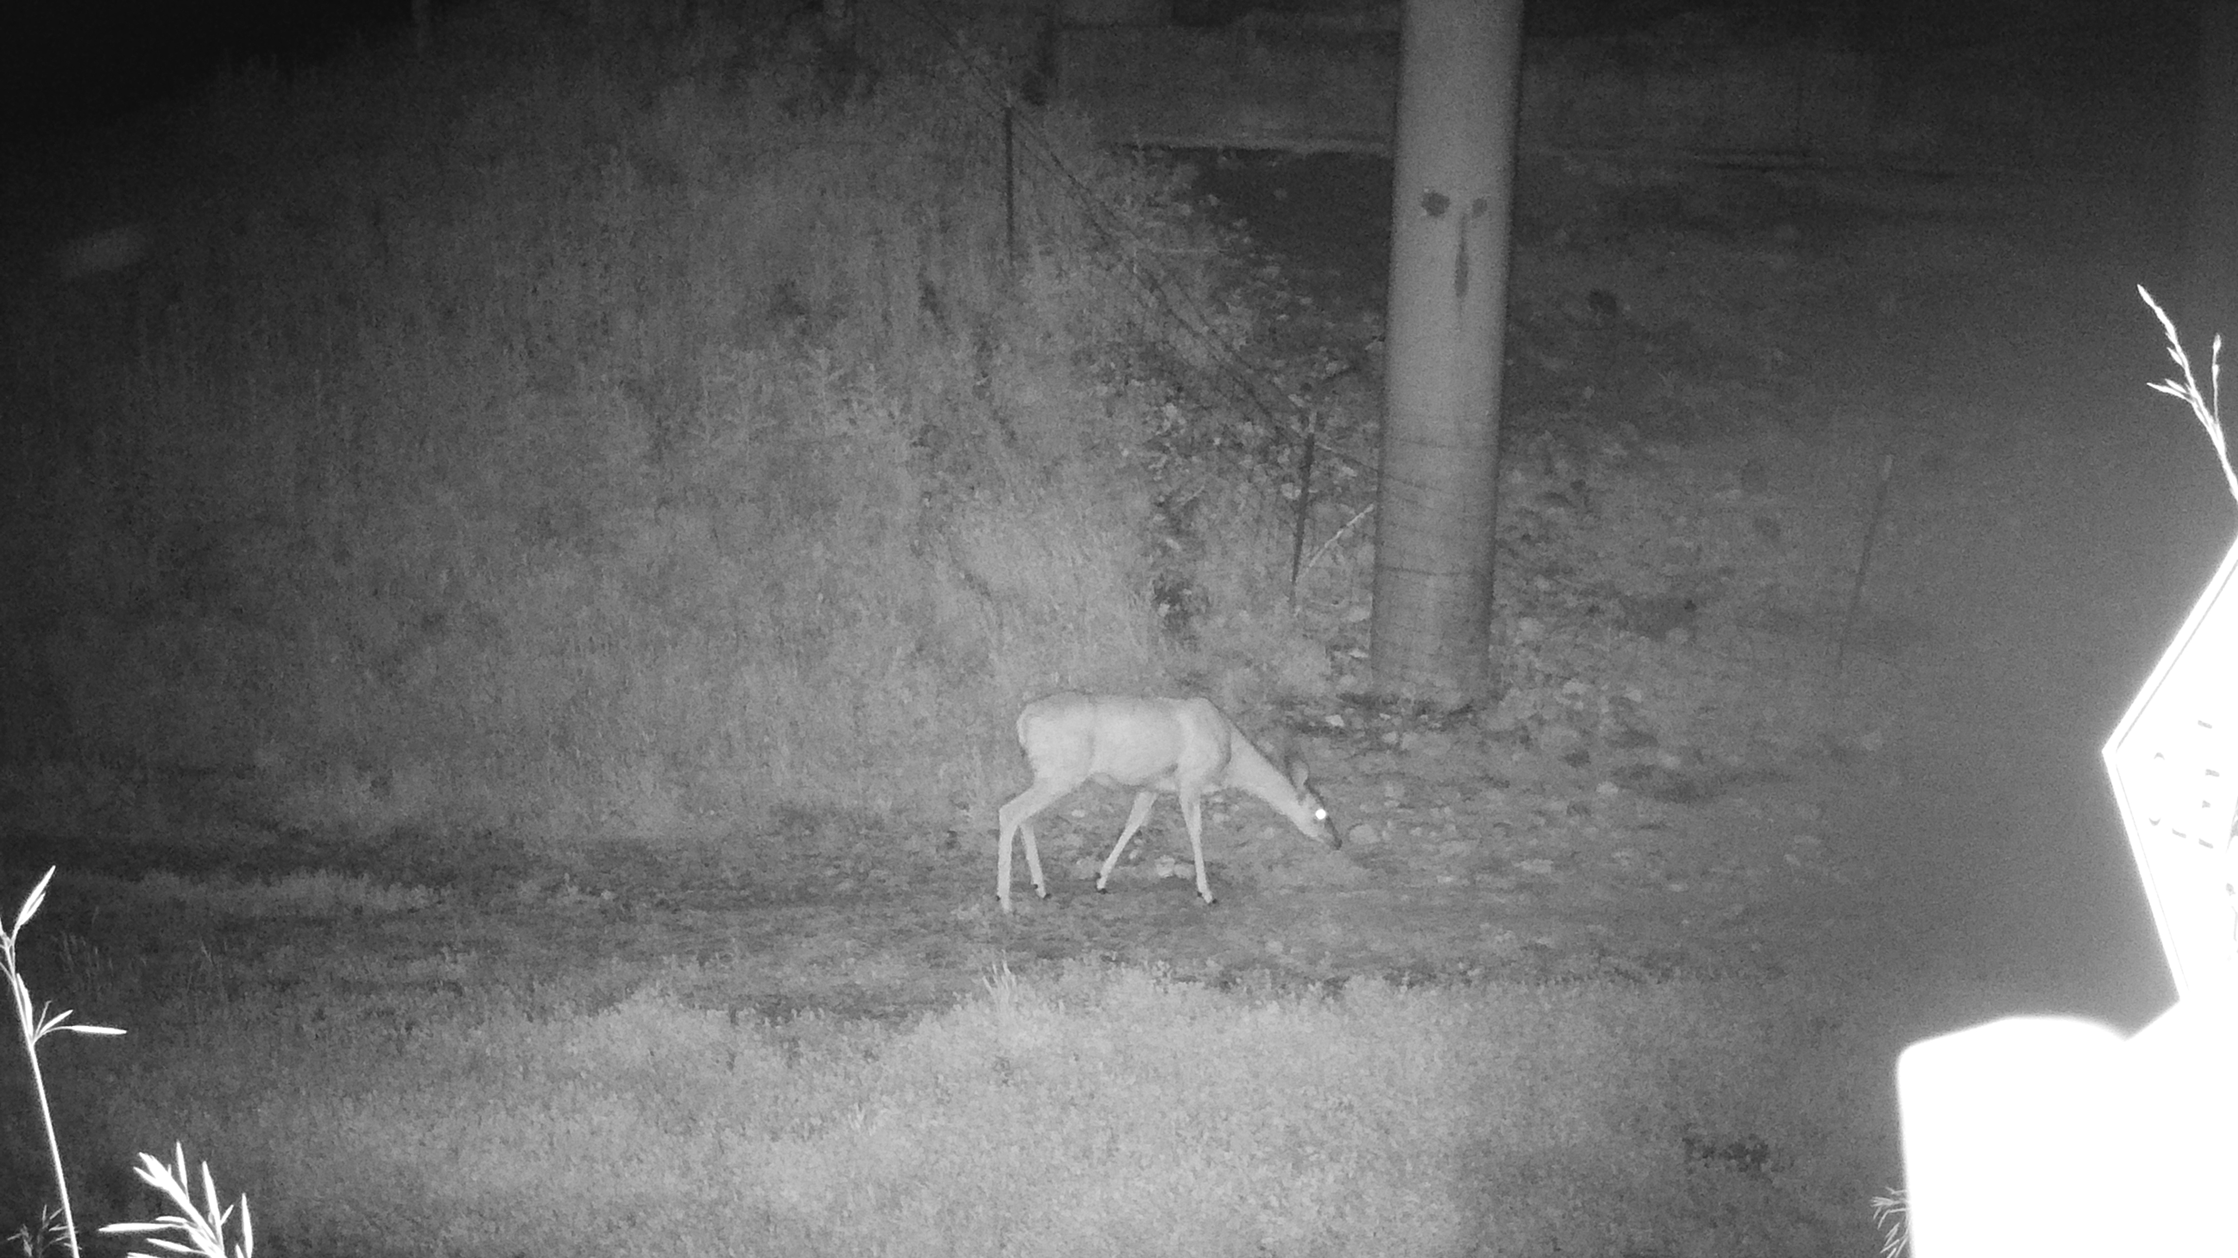

Slide 9
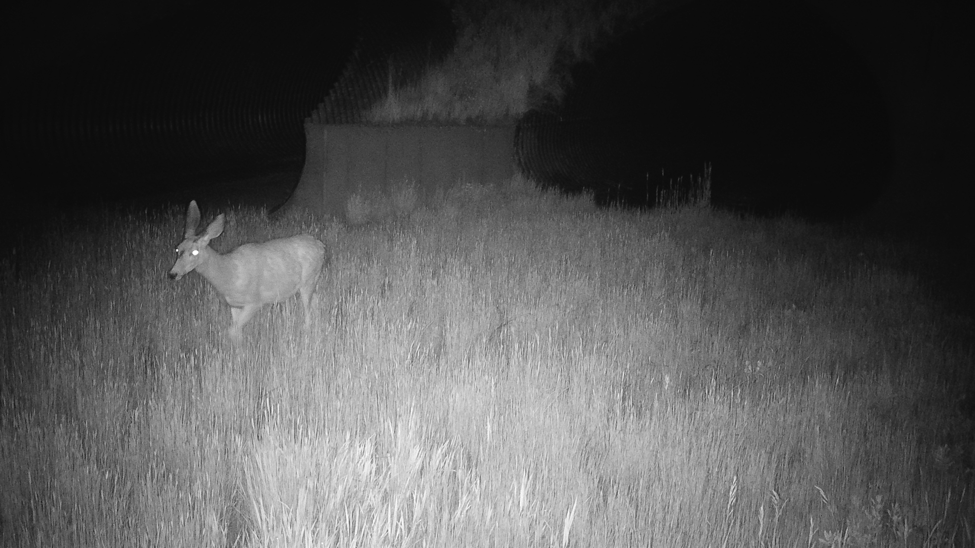

Slide 10
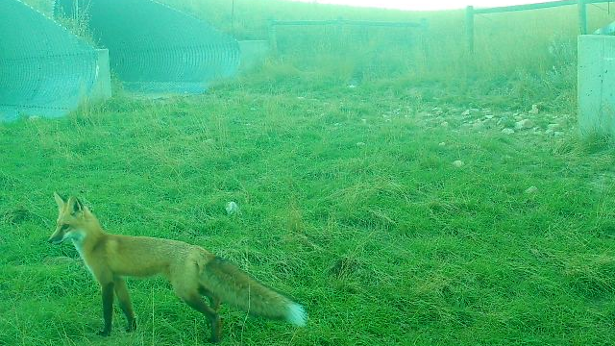

Slide 11

WYldlife for tomorrow
Tourism and Recreation Business partners investing in conservation
Wildlife is the top driver of Wyoming’s $4 billion tourism-based economy
Over 80 businesses and partners now investing through this effort with over
$225,000 raised
Sampling of Projects Funded:
South Park Wetlands Enhancement $25,000
Cody Regional Beaver Holding Facility $9,900
New Fork River Restoration Project $25,000
WGFD Elk Collaring Research $20,000
Sage Grouse Fence Inventory $15,000
Kelly Hayfields Sagebrush Restoration Project $25,000
Spread Creek Project $20,000
We’re actively pursuing new projects across the State of Wyoming

Slide 12
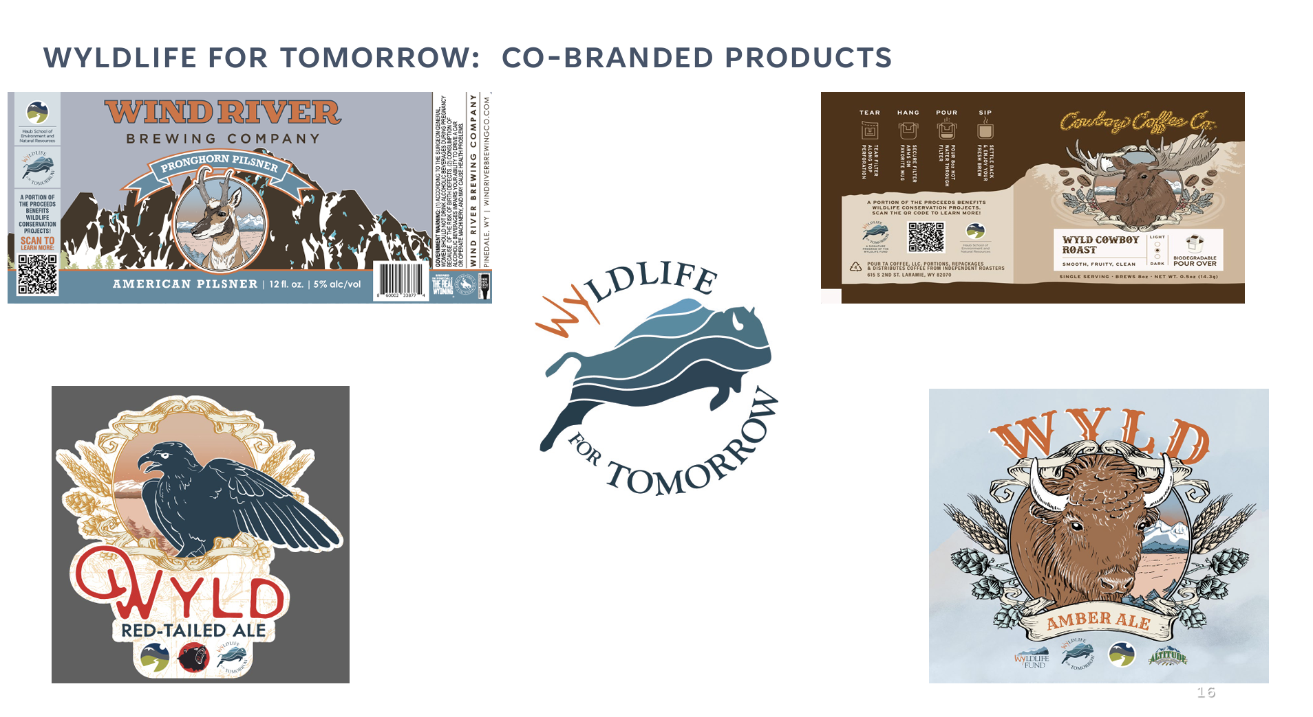

Slide 13
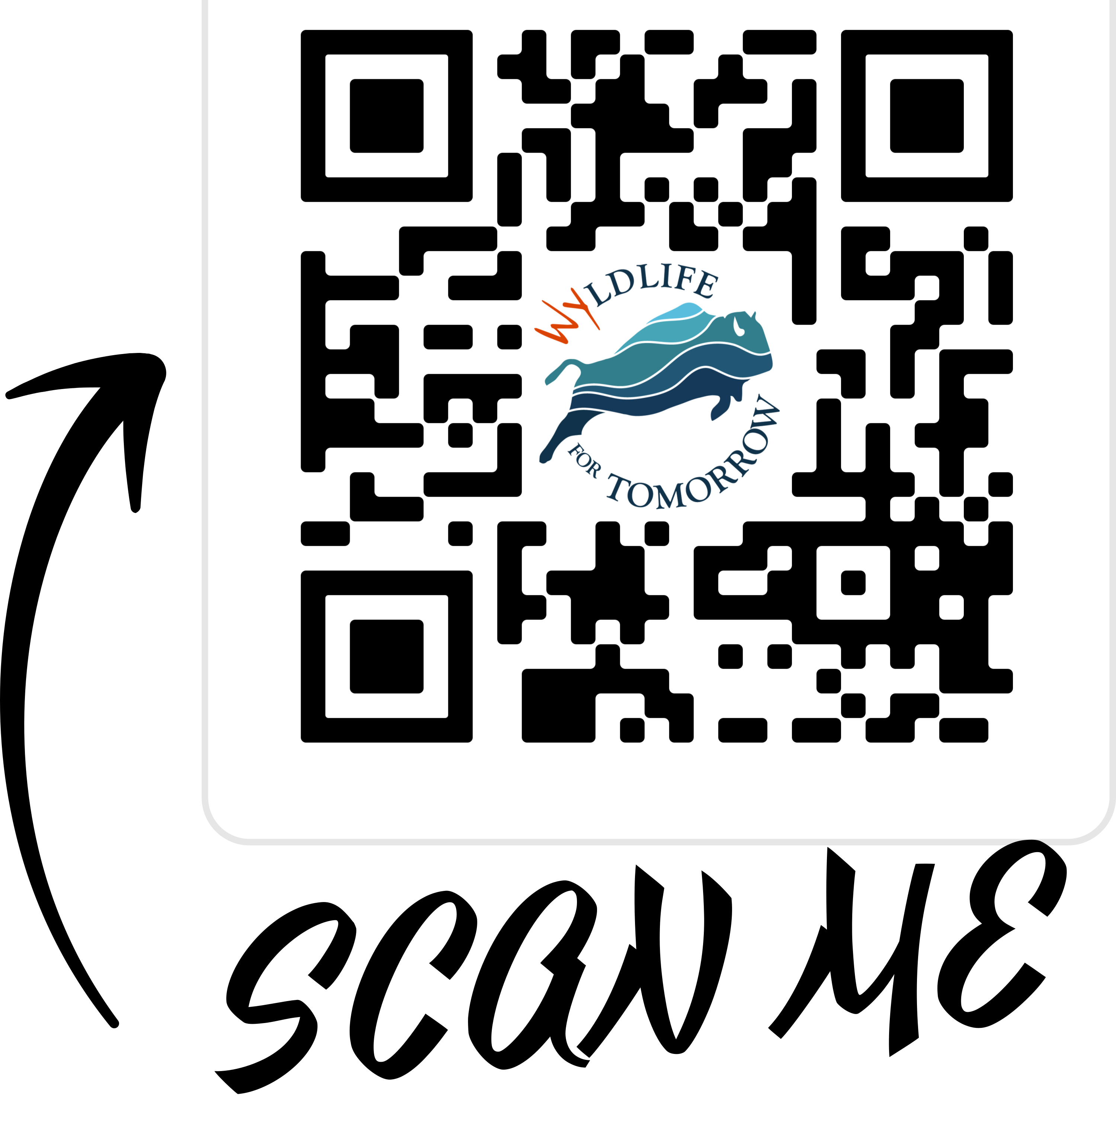
Thank you
Partnerships, Collaboration and Communication
provide powerful results for Wyoming’s wildlife and
wild places
Taylor Phillips
307-690-2602
taylor@thewyldlifefund.org
Chris McBarnes
307-316-3863
chris@thewyldlifefund.org
www.thewyldlifefund.org

