Slide 1


Slide 2
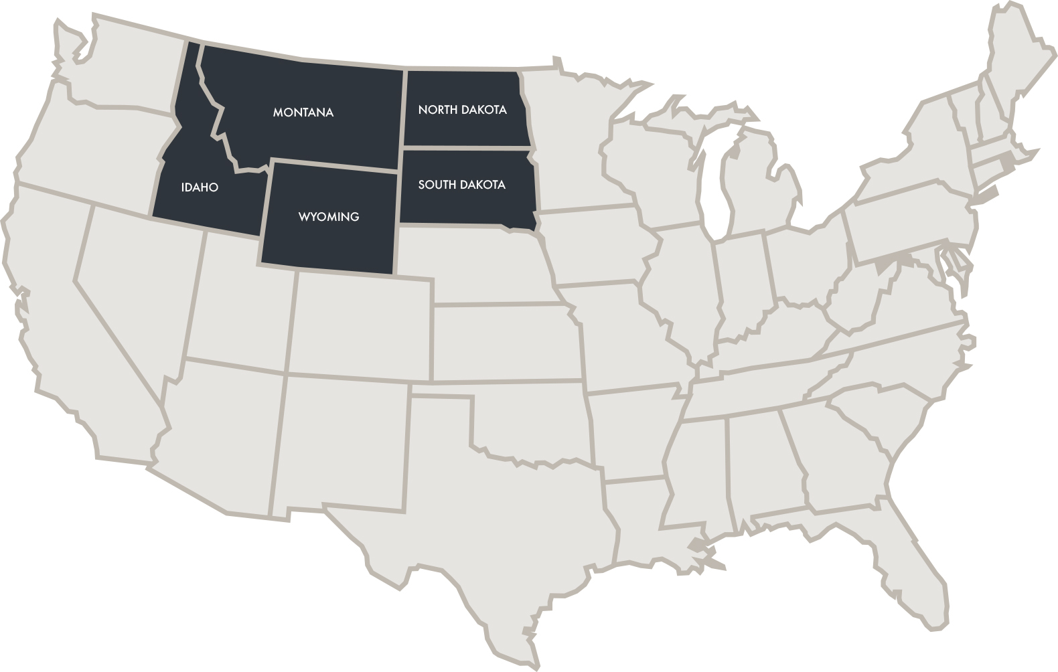



The Great American West

Slide 3
International Markets

Slide 4
Why Target International?

Slide 5
Why Target International Travelers?
Time &
Money
Shoulder Season
Unique Desires
Sell More Rooms
New
Base
International travelers stay longer and spend more when visiting the United States
International travelers are more likely to visit during off-peak seasons than domestic travelers
International travelers desire to visit ”off-the-beaten-path” and unique rural attractions
International travelers are an excellent source for hedging unsold hotel rooms
International travelers create a new source of customers for your community, hotel or attraction

Slide 6
Why Target International Tourism Trade?
Easy & Efficient
Insider Knowledge
Consumer Confidence
Custom Requests
Complex Details
Going through the trade is a cost-effective way to reach international consumers
Travel trade have specialized understanding of their markets’ travelers and their preferences
International consumer protection laws incentivize booking with tourism trade
There’s high consumer demand for customized/
tailor-made travel arrangements
Great American West states have complex travel logistics (geographically, large, etc.)

Slide 7
Why International Is Important
National Travel and Tourism Office (NTTO) forecasts ...
82.4 million
62.8 million
international visitors
in 2025 (surpassing
pre-pandemic levels!)
international visitors
in 2023 (this year!)

Slide 8
Why International Is Important
By 2027 ...
91 million
international visitors are expected
to visit the U.S., spending
$279 billion!

Slide 9

Why International Is Important

Slide 10
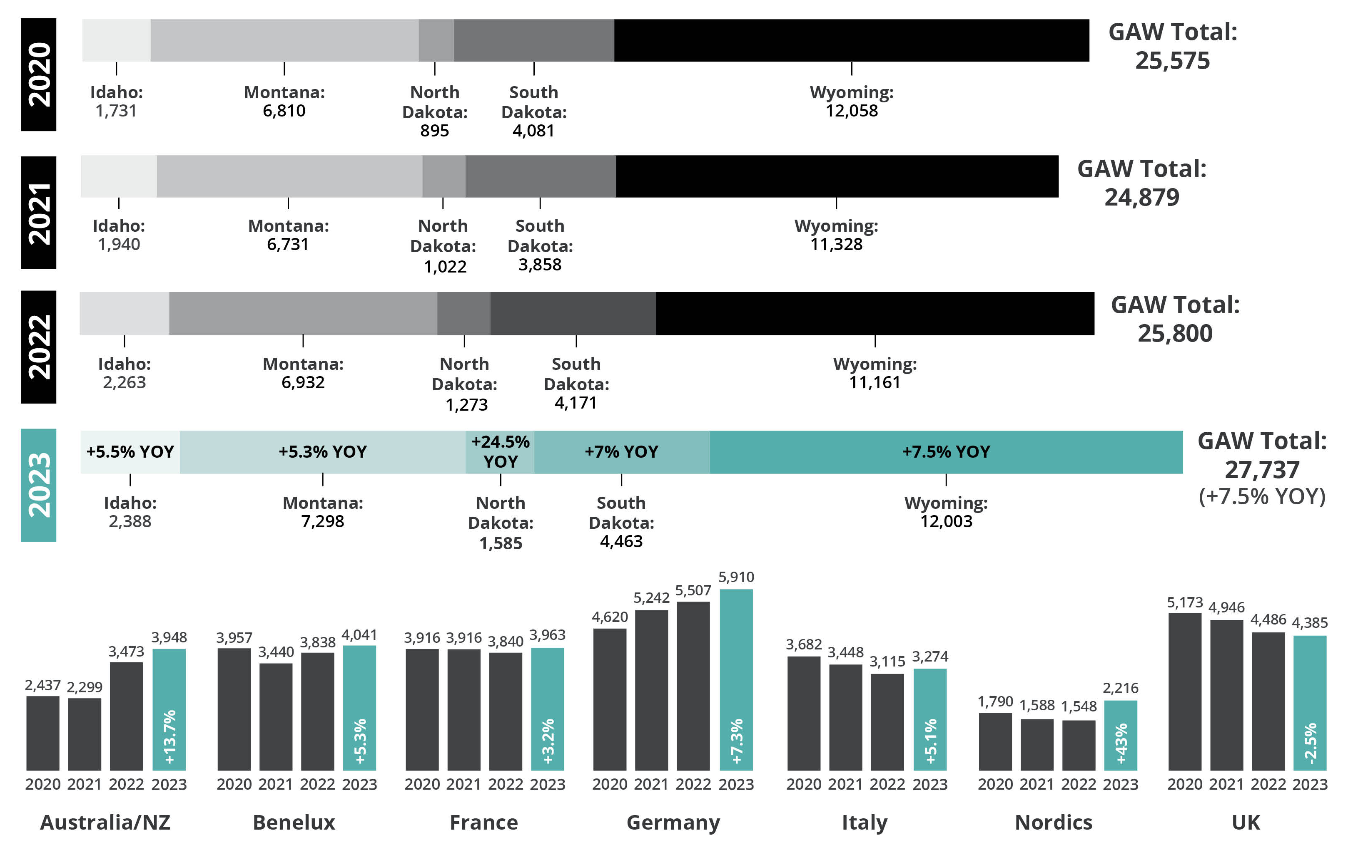
How Is Wyoming Positioned Internationally?
Notes:
+7.5% overnights = more itineraries featuring Wyoming
Over 2,000 more overnights featured than pre-COVID
Demand for Wyoming growing

Slide 11
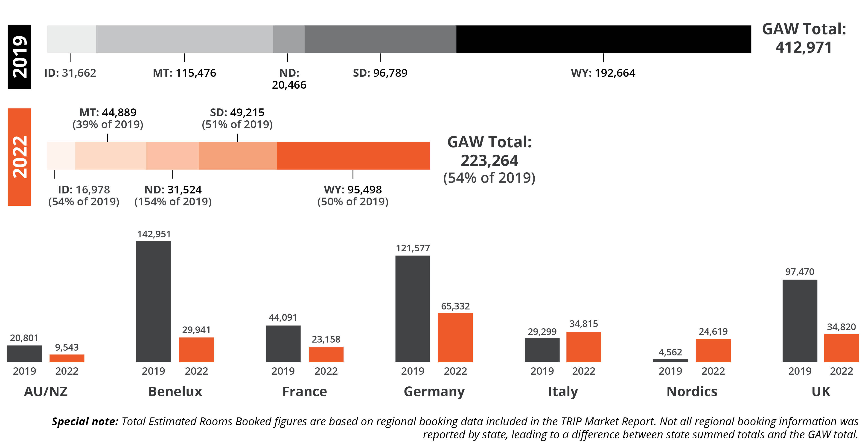
Estimated Rooms Booked Is Rebounding
Notes:
Nearly 200,000 rooms booked by international trade in 2019
We’re about halfway recovered compared to 2019
Germany & UK remain top-producing markets for Wyoming

Slide 12
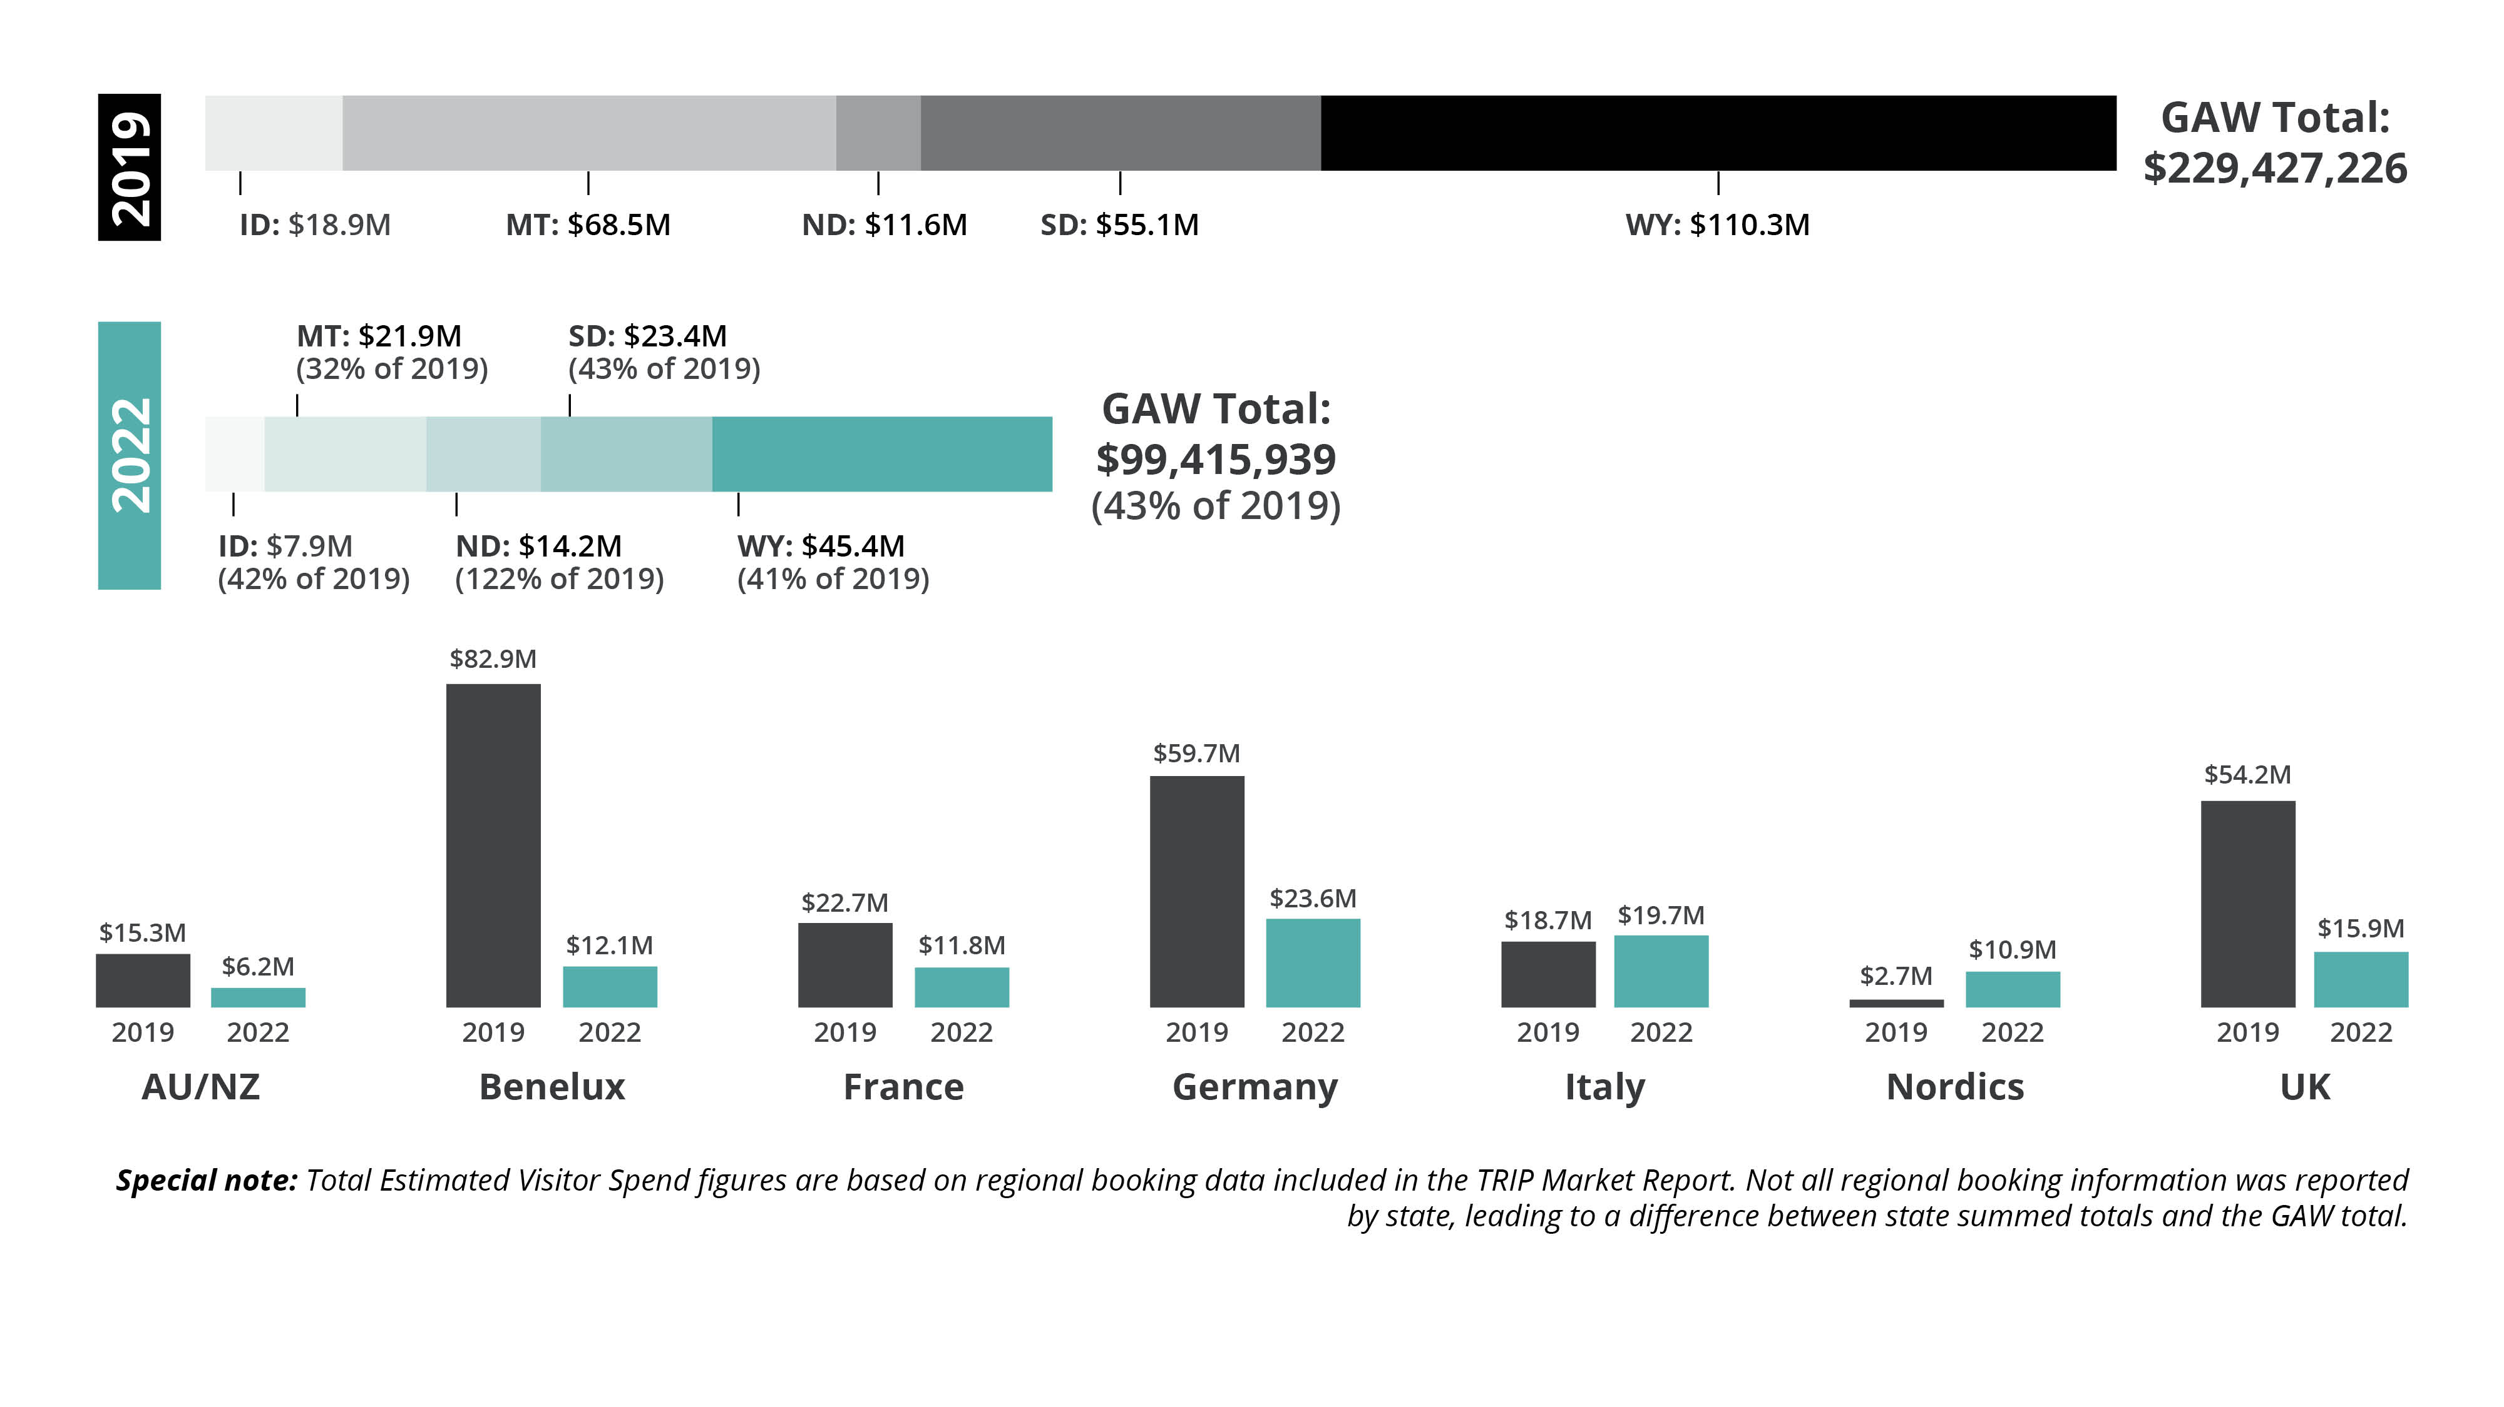
Estimated Visitor Spend
Notes:
Over $110 M in estimated visitor spend Wyoming in 2019
Price consciousness: value of the dollar + inflation makes US very expensive
Pricing a concern: Wholesale, rental cars, food, resort fees, fuel, airfare

Slide 13
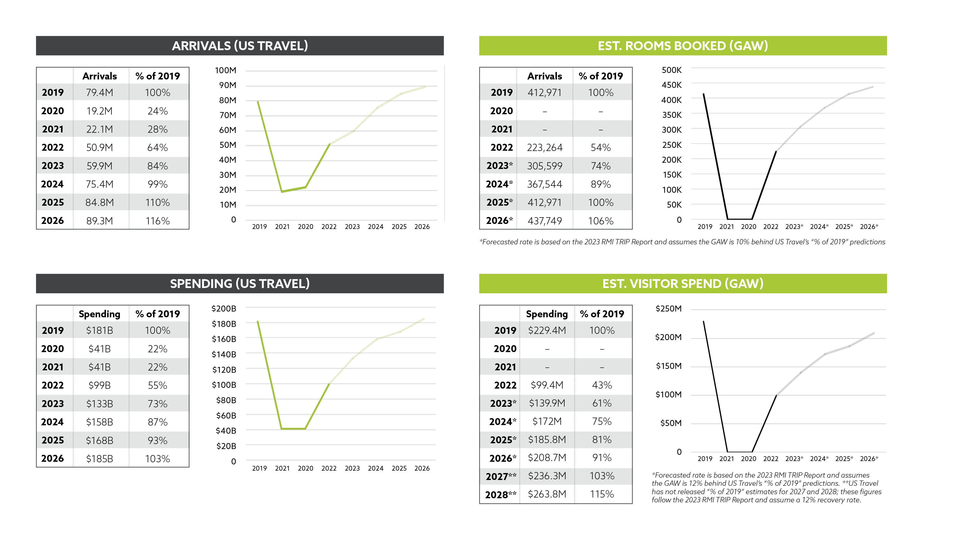
Recovery Forecasts
Notes:
Full recovery back to 2019 levels expected by 2025 or 2026
Expecting over 400,000 estimated rooms booked
And over $230 M estimated visitor spend

Slide 14
RMI TRIP Report
Notes:
2023 Product Audit & 2022 Booking Report
Available for your community

Slide 15
Working with Inbound Tour Operators

Slide 16
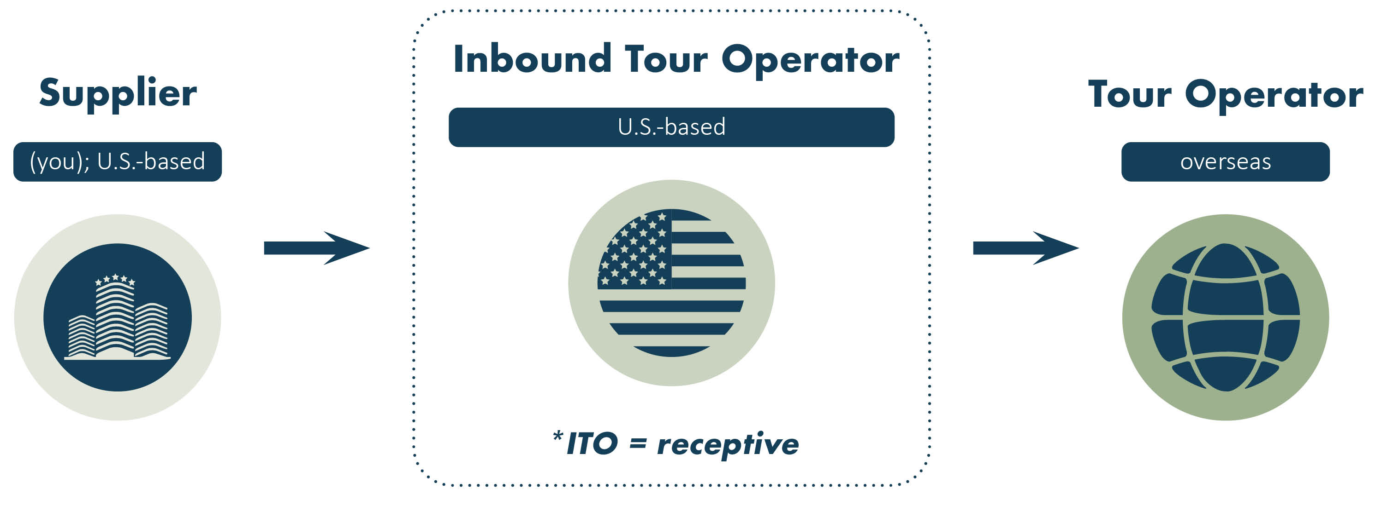
What Is An Inbound Tour Operator (ITO)?
*Contact WOT for additional information and training resources

Slide 17
International Roundup

Slide 18

International Roundup
Casper, WY
April 19-22, 2024
Early-bird pricing extended through October 31!

Slide 19
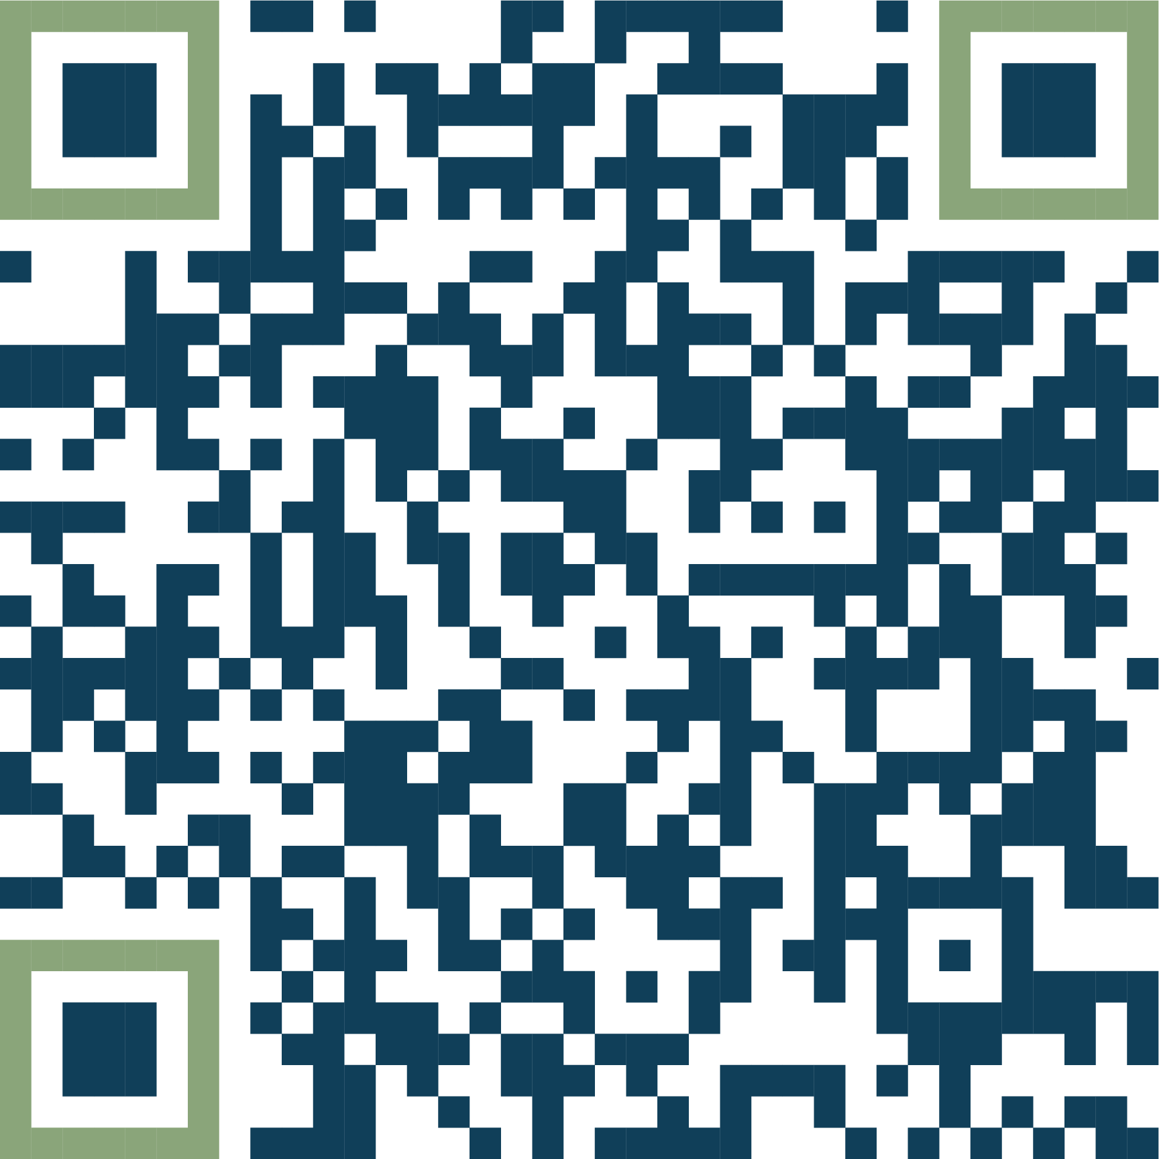

2023 IRU Webinar
2023 IRU Webinar:
TinyURL.com/y2eajwa8
2023 Market Trends:
TinyURL.com/376fucms
Notes:
Insert QR Code here to 2023 IRU Webinar series, 2023 Market Profiles (needs created), ....

Slide 20
GAW Partner Program
IRU Premium Registration
Regional Newsletter
Regional
Social Media
IRU attendance for 2
Access to exclusive TO networking events
Quarterly submissions
Single newsletter submissions
Up to 2 posts per year on all GAW FB pages
Single post
Regional Websites
Reporting
Material Distribution
Dedicated landing page & itinerary spotlight
English-only (4)
English & translated (8)
Monthly media
Quarterly
Annual
RMI TRIP
Leads
Distribute your materials overseas in English or work with us to translate them into an in-market language

Slide 21
More Opportunities
Contact your state rep, they’re here to help!
Attend educational webinars
Consulting services, seminars & training roadshows
Marketing partnerships
Custom product/data analysis, research, insights & reporting services
Public relations
Online advertising on 9 in-market websites
Advertising design & translation
Translation services
Leads program
Host fam tours
Overseas trade shows
Marketing co-ops

Slide 22

Questions?
MATHIAS JUNG,
RMI Owner & CEO
Email: mjung@rmimarketing.com
Website: rmimarketing.com

