Slide 2
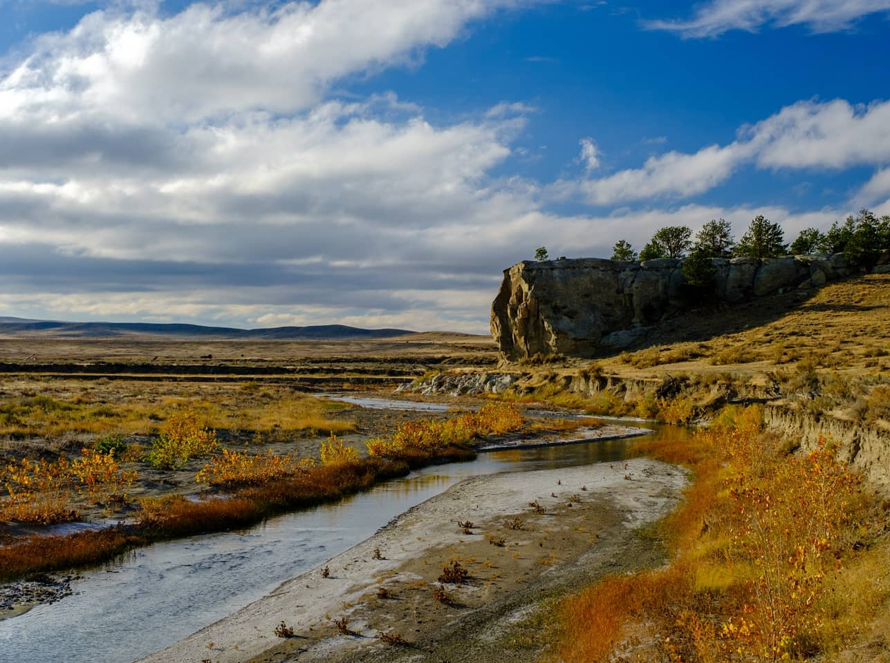
Journalist Hospitality Mastery: The Dos and Don’ts of Hosting Media
Presented by
Sarah Kissko Hersh
From Percepture

Slide 3
Who am I and why am I here?
Percepture works as an extension of the WOT PR team, providing support in media communication and strategy, press trips, and more
We work with prioritized media to tell stories that inspire travel to Wyoming via:
In person media events
Virtual and face-to-face editorial appointments
Pitching
And for select media only: hosting a customized visit

Slide 4
In 15 minutes or fewer I will…
Run through some best practices
Pull back the curtain to reveal what media are really looking for
Point out how to signal to media that you are experienced engaging with media
Help you turn a one-time encounter into a long-term relationship
Answer questions

Slide 5
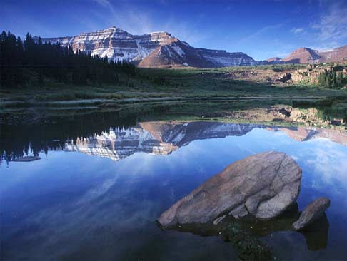
But First…

Slide 6
A Few Things to Keep in Mind
All opportunities we bring to communities and individual partners are thoroughly vetted for quality
Hosting a writer requires time, effort and potential financial investment for meals, hotel rooms, and activities

Slide 7
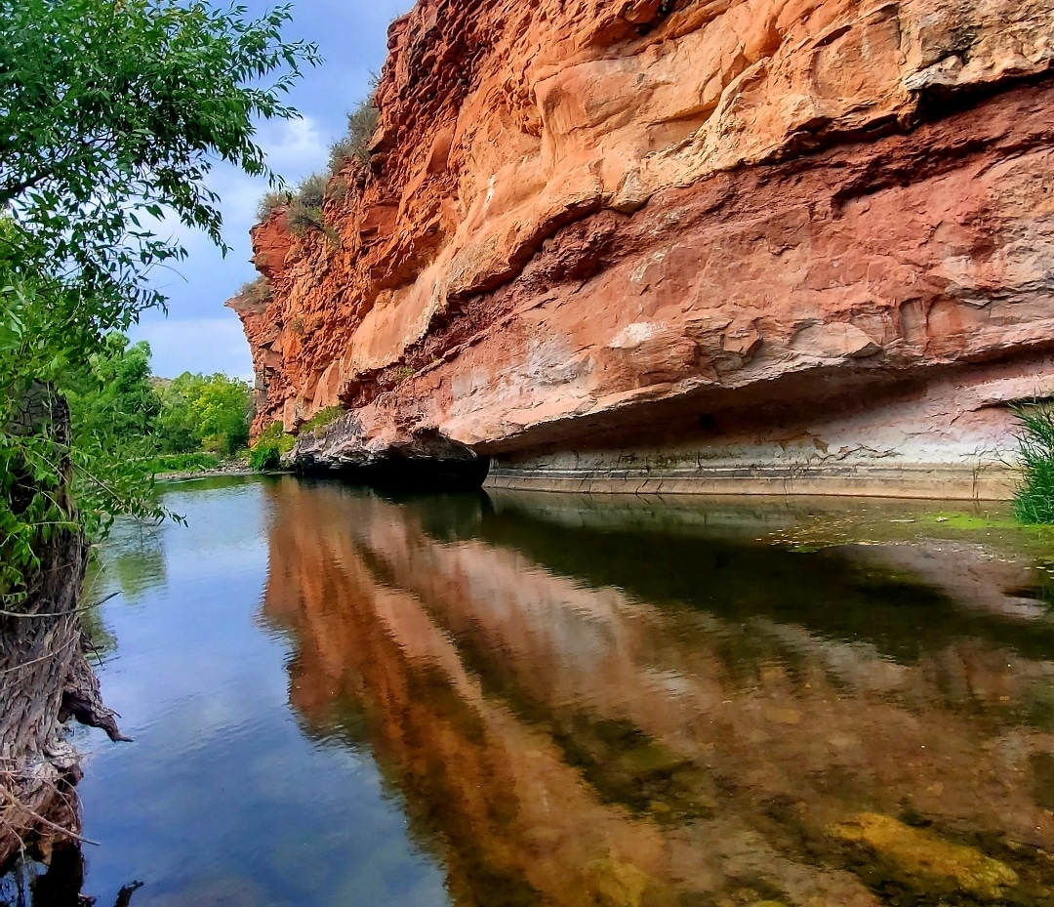
Dos and Don’ts

Slide 8
Do
Offer behind-the-scenes access and provide special experiences
Have data, factoids, tidbits, anecdotes handy
Find a clever way to describe something
Have editorial quality images and b-roll, if at all possible
Tailor your content to what the writer’s audiences are looking for
Be realistic with the media, journalists respect transparency and honesty
Remember that you don’t have to be everything to everyone, it’s ok to have a niche

Slide 9
Don’t
Lose sight of the topic or theme at hand that got you in the door
Schedule every second, leaving no time for free exploration and discovery
Lean on WOT to handle everything
Look at this as a one-off, instead play the long game
Forget that what is everyday ho-hum to you, might seem very interesting and even exotic to an outsider
Be cavalier about safety
Delay in responding to requests and leads from Hailey and Piper, who are usually working with a writer on a tight deadline

Slide 10
Keeping The Love Alive
Follow up afterward to say thank you, provide any missing details, and offer your availability if they have any follow up questions or needs
Give some space between that follow up and your next outreach, unless there is truly something pertinent to provide
Start to follow them on social media and/or read their coverage. You can comment in a meaningful way, but not too frequently
Don’t forget to say thank you when the coverage comes out!

Slide 11
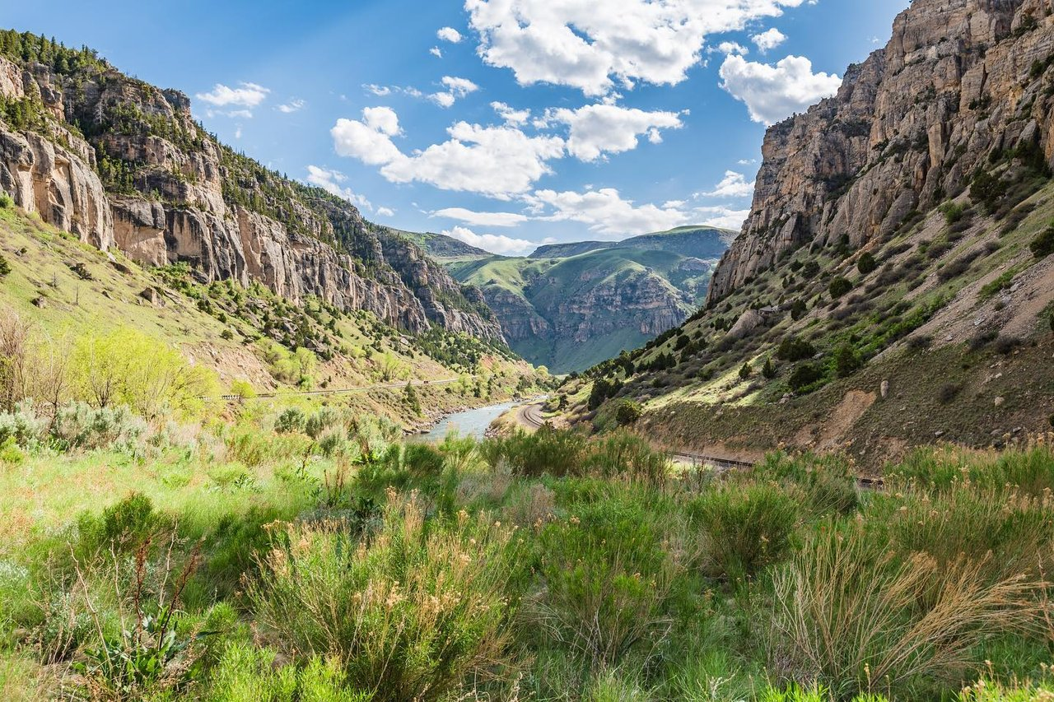
Bonus Content

Slide 12
A Few Tips on Media Interviews
When asked a question, give your answer and then pause. This frees up time for the writer to ask more questions and learn more details (if they need more info, they’ll ask you!)
Stick with the spirit of the interview. If the writer is interested in winter activities, do not keep circling back to how great your town is in the summer
If you don’t know the answer, just say you’ll look that up and get back to them later that day or tomorrow
Writers are always on deadlines, try to be as flexible as possible when scheduling interviews (and don’t be late!)
Avoid jargon and acronyms
Be aware of your surroundings and avoid editorializing about politics, gun rights, world events, etc.
Show, don’t tell
Nothing is ever off the record

Slide 13
Success Stories

Slide 14
Questions?
skisskohersh@percepture.com

