Slide 1
2023 Fall Hospitality and Tourism Summit
Tax Structure 101 & Legislative considerations

Slide 2
The Tax Collector’s Creed
“The art of taxation consists in so plucking the goose as to obtain the largest possible amount of feathers with the smallest possible amount of hissing.”
- Jean-Baptiste Colbert, Finance Minister (1665-1683), King Louis XIV

Slide 3
What is the purpose of taxes?
“Taxes are the structure by which we as citizens pool our resources to pay for infrastructure and services we could not afford on our own. The goal for those responsible for administering those taxes is to ensure taxpayers are paying their fair share of the tax burden. No more, no less. It is the responsibility of the legislature to determine what that amount is.”
- Brenda Henson, Director of Wyoming Department of Revenue

Slide 4
Wyoming Taxpayers Association
What is the WTA?
Notes:
Since 1937, WTA has advocated for sound tax policy for a healthy Wyoming economy. We are not anti-tax or pro tax we are a non-profit 501 (c) (4) corporation think tank with a 501 c3 foundation – research arm
Our membership is diverse from large companies to family business, mineral producers to ranchers, corporations to cooperatives, elected officials to private citizens.

Slide 5
JUSTIFIED
Is there a justified need for the tax and is it fiscally prudent?
Are existing government funds spent efficiently before considering a new tax?
Is the primary goal of the tax to generate revenue or does it modify behavior or influence policy?
EQUITABLE
Does the tax impose equal and uniform liabilities upon similarly situated taxpayers?
Is the tax constitutional?
Does the tax disadvantage one taxpayer over another?
Will the tax distort economic behavior?
STABLE
Is the tax stable and predictable under changing political, economic, regulatory and environmental conditions?
Does the tax result in diversification in taxation?
TRANSPARENT
Is the tax visible, accountable and auditable?
Is the tax easy to understand, administer and cost effective to collect?
Notes:
WTA’s Cornerstones of Taxation – provides a litmus test for all tax policy that stands on four key principles. This tool helps Wyoming policy makers pave the road to sensible solutions to tax policy questions and promotes “good tax policy” for proposed legislation by asking is it Justified, is it Equitable, is it Stable and is it Transparent?
This model helps the WTA in determining its position to support or oppose legislative issues.
WTA believes sound tax policies is the foundation for economic development.
Everyone has a voice in the process. Members benefit from the input of all members, not just a few. The WTA works in cooperation with other professional associations - working jointly on issues to support the best interests of the taxpayer.
Allowed us to major champions for the lodging tax (also was a tax reform 2000 initiative)

Slide 6
Tax Reform 2000 Committee
“Wyoming’s tax structure lacks equity, stability, and balance.” – Tax Reform 2000 Committee
Inequitable: structure is regressive (lower income households pay a larger percentage of income in excise and property taxes than households with higher income).
Unstable: mineral production taxes based on market values many of which are subject to national and international volatility.
Lacks balance: Tax structure reliant on extractive industries to fund operating budget (income inelastic as mineral tax collections are unrelated to state income changes).
Primary tax sources: Almost 75 % of the State’s tax revenue is generated by property taxes, mineral severance taxes, and sales & use taxes.
https://wyotax.org/research-education/wyoming-tax-reform-2000/
Notes:
Since the inception of the severance tax in the 1970s Wyoming’s tax structure has been beholden to the boom-and-bust nature of our legacy industries. By the late 1990s the writing was on the wall as there were major deficits and rising costs of education. In 1997 WTA Exe Dir Michael Walden Newman collaborated with Governor Jim Geringer’ s office to create a discussion on Wyoming’s tax structure for the WTA Annual Meeting. The debate was if we started from scratch what would it look like?? If we implemented these changes now, how different would the finances of the state look? Post meeting, this discussion moved forward as WTA Executive Director Walden-Newman wrote a draft bill to create a tax committee appropriately named Tax Reform 2000.
This special legislative tax committee created bipartisan recommendations. All those recommendations stay the same for today. Wyoming’s tax structure is inequitable, unstable, lacks balance and at the time almost 75% of the state’s tax revenue was generated by property taxes, severances taxes and sales and use taxes from the minerals industry.
So let’s fast forward to today – 22 years and counting – sad to say much remains the same. However, we have slightly moved the needle. 32 actions have been taken by the legislature based on recommendations from the Tax Reform 2000 Committee and there have been 50-60 additional bills that have been introduced but defeated. You can find all this online wyotax.org

Slide 7
Major Components of
Wyoming’s Tax Structure
Property Tax - 47%
Property tax for mineral production 51% of FY23 total
Effective tax rate on owner-occupied housing value 0.56% (#47)
General Sales Tax - 26%
State tax rate 4%, avg. local rate 1.36% = 5.36% combined rate (#43)
Severance Tax - 22%
6% of value on oil & gas, 4% on stripper oil
7.0%* of value on surface coal, 3.75% of value on underground coal. 6.5% as of January 1, 2021
Other Taxes - 5%
Fuel tax $0.24/gallon (#38)
Cigarette tax $0.60/pack (#43)
Alcohol – Beer $0.02/gallon (#50), Wine $0.28/gallon,
Spirits $0.94/gallon (no ranks)
Insurance premium tax
Franchise tax
Wind generation tax
NO INDIVIDUAL INCOME TAX
NO CORPORATE INCOME TAX
Source: Wyoming Legislative Service Office Fiscal Profile 2023, Wyoming Department of Revenue, Tax Foundation
Notes:
So what do our revenues look like today?
Everyone in the state of Wyoming enjoys no individual or corporate income tax so we rely heavily on property and sales tax.
In FY 2021, 52% was raised through property tax of which 45% of the property tax was accounted for through mineral production.
General Sales tax accounts for 33%
While Severance tax accounts for 9% of Wyoming’s revenues.
Other taxes equate for about 6% which include things like fuel tax, cigarette and alcohol taxes, insurance premium taxes, franchise taxes and the wind generation tax.

Slide 8
Major Components of Wyoming’s Tax Structure
How Does Wyoming Compare?
 | Sales Tax Rate (%) | Income Tax Rate (%) | Property Tax Burden ($)
Montana | 0% | 6.75% | $ 3,640.00
Colorado | 7.79% | 4.40% | $ 2,730.00
South Dakota | 6.11% | 0% | $ 4,725.00
Nebraska | 6.97% | 6.64% | $ 6,965.00
Utah | 7.20% | 4.85% | $ 2,625.00
Wyoming | 5.44% | 0% | $ 2,503.00
Sources: Wyoming Department of Revenue, Tax Foundation

Slide 9
Excise – The Power of a Penny
Sales and Use Tax
($)
Local total (29%) | $359,259,108
Local Admin. Expense (1%) | $12,388,245
State total (69%) | $854,788,911
State Admin. Expense (1%) | $12,388,245
Total Sales and Use Tax Collected FY 2022 | $1,238,824,509
Source: Wyoming Department of Revenue, FY 2023

Slide 10
Excise – The Power of a Penny
SALES TAX TYPE | AMOUNT | COUNTIES & DISTRICTS THAT LEVY
Statewide | $0.04 | 23
General Purpose | $0.01 | 21
Specific Purpose | $0.01 | 12
Municipal Purpose | $0.01 | None at this time
Resort District | $0.03 | 2
Econ Development | $0.01 | 2
Source: Wyoming Department of Revenue, FY 2023

Slide 11
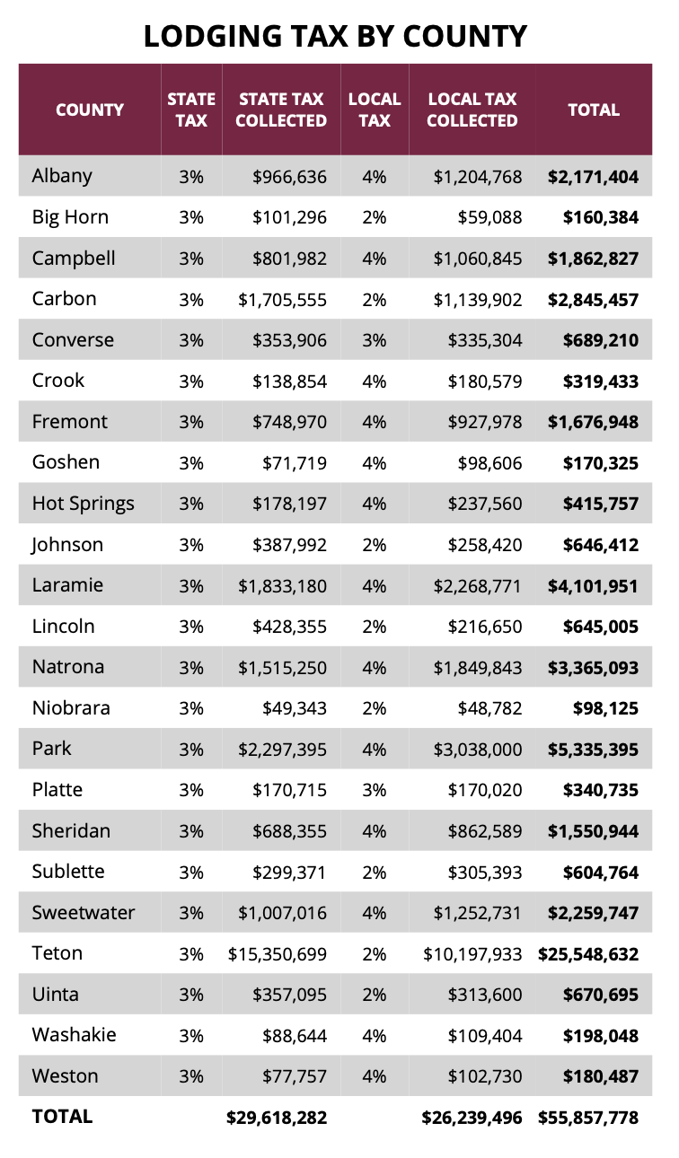
Excise & Tourism - The Power of a Penny
Lodging Tax (State & Local)
Wyoming Tourism Account (State) $23,694,626
Wyoming Tourism Reserve Account (State) $5,923,656
Local Tax Collected $26,239,497
Total State & Local $55,854,778
Source: Wyoming Department of Revenue, FY 2023, Wyoming Office of Tourism

Slide 12
Tourism Impacts on Wyoming’s Revenues
Source: U.S. Bureau of Economic Analysis

Slide 13
Tourism Impacts - Wyoming GDP by Industry
Source: U.S. Bureau of Economic Analysis

Slide 14
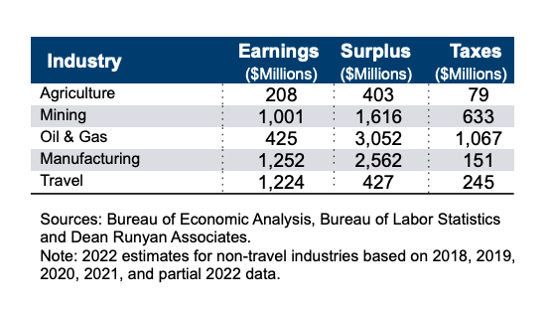
Tourism Impacts on Wyoming’s Revenues
Source: U.S. Bureau of Economic Analysis

Slide 15
2023 Property Tax – How it is derived
How It’s Derived
($ Millions)
Mineral Production | $1,144
Residential Property | $639
Industrial Locally-Assessed | $160
Industrial State-Assessed | $91
Commercial Property | $138
Agricultural Lands | $28
TOTAL TAX REVENUE: | $2,200
Source: Wyoming Department of Revenue, FY 2023

Slide 16
2023 Property tax – How it is used
How It’s Used
($ Millions)
Public Schools | $1,524
County Government | $385
Special Districts | $172
Community Colleges | $78
Cities and Towns | $41
TOTAL: | $2,200
Source: Wyoming Department of Revenue, FY 2023

Slide 17
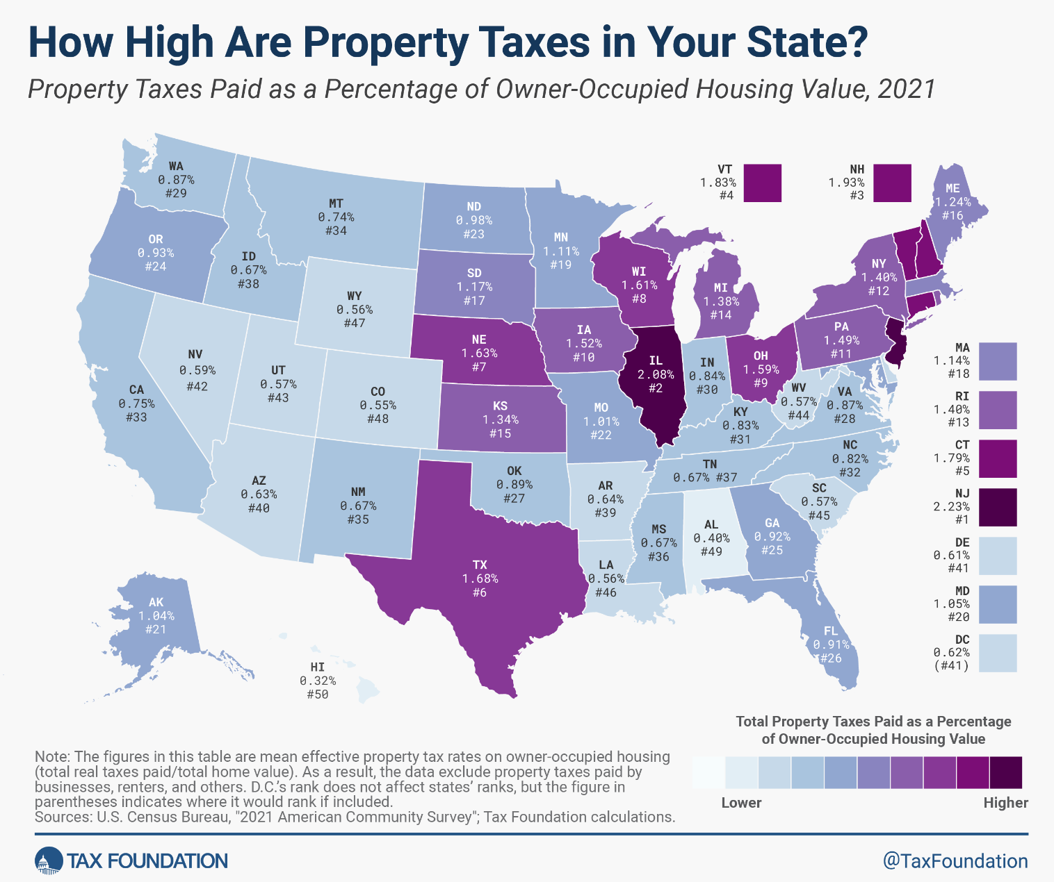
Residential Property Tax -
How Does Wyoming Compare?
Notes:
Wyoming ranks 47th or the 4th lowest effective property tax value. Other states include Colorado, Alabama, Hawaii

Slide 18
Direct Tax Collections &
Public Service Costs 2021
For a 3-person family with income of $67,000 and owning a home valued at $290,000
Personal Tax Collections
Retail Sales $ 1,150
Gasoline $ 210
Cigarettes $ 120
Alcohol $ 110
Vehicle Registration $ 600
Property Tax $ 1,780
Public Service Costs
County $ 2,810
City/Town $ 3,070
Special District $ 6,290
K-12 Education $ 7,570
State Services $ 7,810
$27,550
$ 3,990
Source: Department of Administration & Information, Economic Analysis Division 2022
NOTE: Excludes Federal Funds and Enterprise Revenues
Notes:
According to the Economic Analysis Division in the State Department of A & I, the 3-person family with an income of $67,000 and owning a home valued at $290,000 the average tax collected is $3,990 while the public service costs of $27,550 for services which include things like law enforcement, public works, leisure and rec, transportation, healthcare and education.
To simplify this equation, know that every $ 1 the average Wyoming citizen pays in taxes results in $6.90 in public service.
I would like to NOTE - this does NOT include Federal funds - In 2020 Wyoming citizens and businesses sent over $6.4B to the federal govt in and received $7B back in payment – employment, support of our parks, federal matching $ roads, etc. There is overall a very low personal tax burden

Slide 19
What does this mean for economic
development and diversification?
Economic diversification efforts are unable to improve revenue flow in Wyoming – without tax reform
Notes:
After thinking about the previous information, it makes one wonder, what does this mean for the state’s revenues if we diversify??
Those were the exact thoughts of former Revenue Chairman Mike Madden. He wanted to draw out the data to quantify changes in our economy. In June 2018, Regional Economic Models, Inc. (REMI) presented fiscal impacts of economic diversification under Wyoming's current tax structure to the Joint Revenue Committee-
Looking at 4 different industries – Oil & Gas, Chemical Manufacturing, Utilities, and Food Manufacturing namely in agricultural products and then comparing existing tax structures in Wyoming and other similarly situated states – Utah, North Dakota and Kentucky….
REMI said “Under its current tax structure, Wyoming effort to stimulate non-resource sectors in the state presents fiscal challenges. Only growth in resources sectors has significant positive fiscal impacts.”

Slide 20
“Breaking The Pace” Can we make do with less?
Notes/Source: Revenues from the CREG/Previous Revenues include capital gains from Budget Fiscal Data Book / Fiscal Profile, Legislative Service Office/ Additional information from State Economic Analysis Division & Wyomingsense.gov
Notes:
It is helpful to understand the state’s tax structure and revenues as this graph illustrates how that plays into state budgeting.
This is a 20-year snapshot of the state’s General Fund. The bar graphs illustrates the state revenues while the line above notes the appropriations (which please NOTE does NOT include the School Foundation Program which funds K-12 education – another discussion for another day).
As we look at the 21-22 biennium, we started with a $2.96 B budget.
After the pandemic hit, we went to 0 rigs for the first time in Wyoming history, the governor immediately implemented a hiring freeze and 15% cuts in the fall of 2020.
At the 2021 General Session, due to the pending $1.9 trillion American Rescue Plan Act (ARPA) funding, consensus was drawn quickly between the Senate and House for the FY 2021 - 2022 Supplemental Budget which stayed very close to the Governor's original recommendations of about $430 million in cuts to the General Fund, which brought it from $2.9B about $2.5 B with the elimination 324 predominantly vacant positions.
In total this equated for a 39% decrease compared to $4.1B 10 years ago (2.9 to 2.5)
The 23-24 Biennium budget, which will begin July 1, 2022, the Governor recommended a flat budget of roughly $2.9 B. This 2022 Budget Session, the Joint Appropriations Committee worked the Governor's recommendations and presented the legislature with approximately a $2.9 billion General Fund budget in the form of two mirror bills SF 0001 General government appropriations and HB 0001 General government appropriations - 2. After all the dust has settled, the final budget 23-24 biennium budget the legislature appropriated is at $3 B.
The 67th passed 383 M supplemental budget for FY 23-24.
State of WY FLUSH with cash $$$. Federal $$$ (CARES, ARPA, IIJA)
Total $3.383 B budget.
Approximately $1.41 B was recommended to be appropriated for savings, of which $725 M is permanent savings with a 50/50 split to Common Schools Permanent Fund and the Permanent Mineral Trust Fund.
The Governor noted, “for every dollar of state revenue spent, the supplemental budget saves $3.50”. He also noted the budget saves over $1 billion which allows “the state to keep taxes low and generate higher investment returns that will benefit future generations.”

Slide 21
2024 Budget Session
2023 Interim Priorities with fiscal impacts
Budget Year!
2/3rds vote for bill introduction
Must present balanced budget
Appropriations
Budget!
Flushed with cash – waiting on October CREG
Priority 1: Pension Plans, Unemployment Insurance and Workers Compensations
Priority 2: Performance Compensation and State Treasurer’s Office
Priority 3: Environmental, Social, and Governance Issues
Priority 4: Major Maintenance Review
Priority 5: Statutory Responsibilities and Reports

Slide 22
2024 Budget Session
2023 Interim Priorities with fiscal impacts
Revenue
Priority 1: Electrical Generation tax
Priority 2: Property Tax Issues
Acquisition Value - 2 draft bills *requires 4 constitutional amendments
The committee moved to draft two bills for consideration at the next meeting. One will amend the state constitution and the other will consider a land acquisition value property tax system.
2023 Property Tax Refund Program 24LSO-0252 Property tax refund program
8,813 applications refunded $8,263,783.84
Rejected applications over the income limit (57%), lack of information (25%), and over the asset limit (13%)
Proposal expands 6 income tiers, funded by GF, before changes estimated COST = $10 m
Homeowner tax exemption - 24LSO-0187 Homeowner tax exemption *possible constitutional violation
25.6% exemption of fair market value, resides in WY 8 months out of the year, does not exceed $200,000 fmv
COST = $84.6 m TY 2025/FY 2026, $87.1 m TY 2026/FY 2027 and $89.6 m for TY 2027/FY 2028, no backfill
Property tax exemption for long term homeowners - 24LSO-0188 Property tax exemption for long term homeowners
50% exemption if owner/spouse is 65+, paid in WY 30 years+, resides in WY 8 months out of the year
COST = $10.6 m TY 2025/FY 2026, $10.9 m TY 2026/FY 2027 and $11.3 m for TY 2027/FY 2028
Notes:
24LSO-0252 Property tax refund program - Expands the Property Tax Refund Program by expanding income to include six (6) refund tiers as amended. After heavy discussion, the committee voted to keep the current definition of "gross income" and amended "taxable income" out. The program is funded by the General Fund through an appropriation. Before the changes, DOR was anticipating a cost of $10 million a year, the committee agreed to table the bill and work on a more accurate amendment. PASSED as amended.
24LSO-0187 Homeowner tax exemption - The exemption provides a 25.6% exemption of the fair market value of the residential real property for residents who occupy 8 months out of the year. The exemption is not to exceed $200,000 of fair market value. The total fiscal impact was estimated by LSO at $84.6 million Tax Year (TY) 2025/Fiscal Year (FY) 2026, $87.1 million TY 2026/FY 2027 and $89.6 million for TY 2027/FY 2028. As amended the proposal applies to residences who occupy the residence at least 8 months out of the year. LSO noted this proposal could have a potential constitutional violation. The committee had a robust discussion about cuts in spending and debated backfill, but ultimately failed proposed amendments addressing backfills or sunsets. PASSED as amended.
24LSO-0188 Property tax exemption for long term homeowners - This provides a 50% exemption of the assessed value of the residential real property if the owner or their spouse is 65 years or older and has paid property tax in Wyoming for 30 years and resides in the state 8 months (as amended). The total fiscal impact was estimated by LSO at $10.6 million TY 2025/FY 2026, $10.9 million TY 2026/FY 2027 and $11.3 million for TY 2027/FY 2028. PASSED as amended.

Slide 23
2024 Budget Session
2023 Interim Priorities with fiscal impacts
Revenue
Property Tax Valuation
24LSO-0184 Property tax - inflation cap *requires constitutional amendment to separate residential property from “all other”
Limits max value of increase by CPI or 5% (whatever is less)
Does not include changes, additions or improvements
24LSO-0185 Property tax - residential property valuation *requires constitutional amendment to separate residential property from “all other”
Allows a cap by providing a resolution for a constitutional amendment sperating residential from the “all other” classification
Failed proposals could be back as individual bills:
Property tax deferral
Monthly payments
Mill levy amendments
Notes:
24LSO-0184 Property tax - inflation cap - Limits the maximum annual taxable value of increase for residential property by more than the Consumer Price Index (CPI) or 5% (as amended) whichever is less. This does not include changes, additions, reductions or improvements to the property. This will be contingent of a constitutional amendment to be balloted upon November 2024that will separate residential property from the "all other" classification and effective July 1, 2025. Applies to all residential property. PASSED as amended.
24LSO-0185 Property tax - residential property valuation - Addresses and allows a cap by providing for a resolution for a constitutional amendment separating the residential property from the "all other" classifications. PASSED as amended.
FAILED
2023 HB0121 Property tax deferral program - amendments - This program would be administered by the state instead of a local option by counties. LSO noted this has little to no constitutional violation and would provide another option for residents struggling with sharp tax increases. Those with a mortgage must have the lender sign off on the application. As amended it removed qualifiers and kept it as a county program. FAILED.
24LSO-0183 Mill levy amendments - If the Legislative Stabilization Reserve Account (LSRA) drops below $500 million, the state Auditor notifies the State Board of Equalization which in turn will direct the boards of county commissioners to levy a special property tax not exceeding 4 mills and the revenue will move to the General Fund. If the LSRA exceeds $500 M, the BOE shall lower the 12 mill levy directed to the School Foundation Program (8-11 mills). Additionally, this grants authority to the county commissioners to restrict special district budgets that are 7 times there reserve amounts. TABLED.
24LSO-0182 Property taxes-monthly payments - Allows for monthly payments of property tax payments. Arguments included this was too cumbersome and the administrative burden was too extreme. TABLED.

Slide 24
2024 Budget Session
2023 Interim Priorities with fiscal impacts
Revenue
Priority 3: Sales Tax Administration
24LSO-0226 Sales tax revisions - Revises 18 provisions related to the administration of the sales tax. Amended to take out imposition on oilfield impositions statutes and annual propane surveys. Topics being considered are:
Annual exemption surveys
Clarification of the imposition for the repair, alteration, or improvement of tangible personal property
Power used in the transportation business
Taxation of digital products
Vendor compensation
Resort District Tax
Refund approvals or denials
Excise tax appeals
Vendor licensing thresholds
Voluntarily licensing
Removal of the NAICS code for the manufacturing exemption
Use fee taxation
Remote seller threshold
Principal residence for motor vehicles
Aircraft exemption language
Tax due on free admissions

Slide 25
2024 Budget Session
Interim Priorities
Travel, Recreation, wildlife & Cultural Resources
Priority 1: Commercial Fishing Outfitters and Guides
Priority 2: Wyoming State Museum
Priority 3: Wyoming Outdoor Recreation and Tourism Trust Fund
Transportation, Highways & Military Affairs
Priority 1: Transportation and Highways
I-80 funding
Fuel tax
EV taxes
Notes:
Action: The committee requested two bill drafts for consideration at the next meeting:
Eliminate the state portion of the vehicle registration for diesel vehicles and increase the diesel fuel tax by $0.xx to be revenue neutral for in state drivers and to capture revenue by out of state vehicles; and
Eliminate the $20 of the state portion on the vehicle registration for all vehicles and increase the diesel and gas tax by $0.02.
EV Taxes - WYDOT presented Taxation Details that explained the conversion of a $0.03 fuel tax per kilowatt-hour tax.
24LSO-0089 Alternative fuel tax - electricity amendments PASSED as amended with committee amendments. See the proposed committee amendments for all the changes.

Slide 26
2024 Budget Session
Interim Priorities
Corporations, Elections & Political Subdivisions
Priority 1: Electric Utilities
Priority 4: Special Districts
Minerals, Business & Economic Development
Priority 1: Energy Issues
Priority 2: Carbon Dioxide and Carbon Capture, Utilization, and Sequestration
Priority 4: Oil and Gas Refinery and Capacity Issues
Priority 5: Committee Reports
Select Committee on Blockchain, Financial Technology and Digital Innovation Technology
Priority 4: Previous Legislation
Lean on digital assets
Select Committee on Capital Financing and Investments
Priority 1: Statutory Obligations
Priority 2: Performance Compensation for Investment Staff
Priority 3: Investment of Non-permanent Funds

Slide 27
2024 Budget Session
Interim Priorities
Management Audit
Priority 2: Receive Reports
Department of Audit – Public Funds Division
Priority 4: State Lands
Education
Priority 4: Community Colleges
Funding
Priority 5: Recruiting and Retaining School District Personnel
ECA & block grant
Labor, Health & Social Services
Priority 1: Emergency Medical Services (EMS) / Firefighters
The funding of and definition of critical services

Slide 28
2024 Budget Session
Tax Trends
Investment revenue
Provides 1/3rd of revenue to the budget
Saves taxpayers approximately $3,000 pp
Trust funds +/-
+ Do we use today’s $ for today’s problem and fight high inflation costs?
Benefit is cheaper today, more expensive tomorrow
+ Do we save today’s $ for tomorrow’s problems and fight low returns?
Benefit is it saves future taxpayers
New mineral wealth
Election year
Constitutional amendments
Ballot initiative
“Don’t tax you, don’t tax me, tax the fellow behind the tree”

Slide 29
Resources
wyotax.org
wyotax.org/research-education/publications
wyotax.org/research-education/wyoming-tax-reform-2000/
wyoleg.gov
wyoleg.gov/budget/2023databook.pdf
drivethrive.wyo.gov
Wyomingsense.gov
Wyoming Department of Revenue 2022-3 Annual Report
Wyoming State Budget

Slide 30
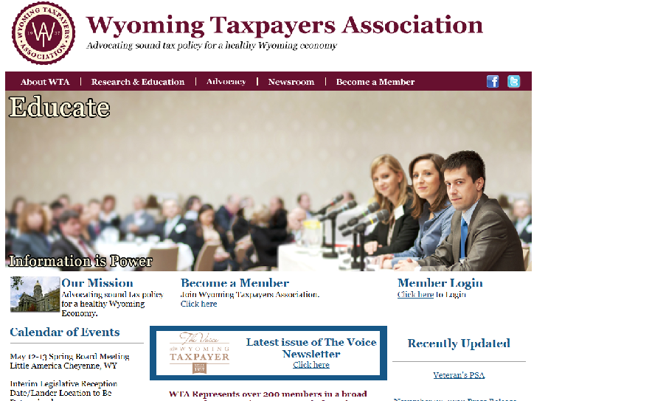
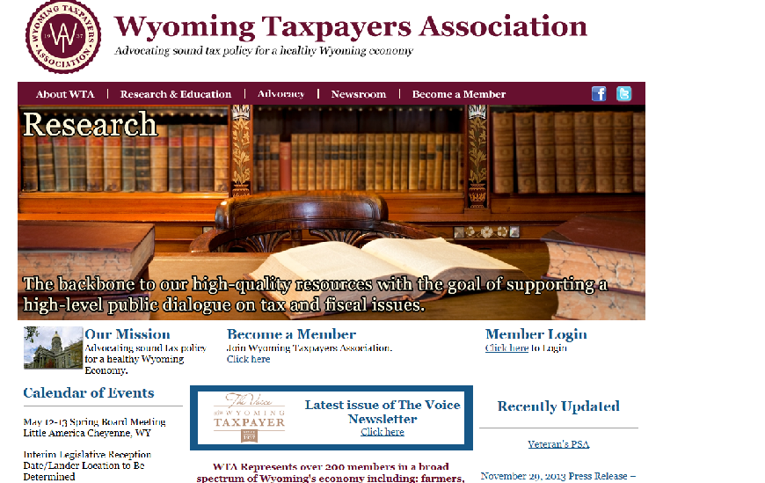
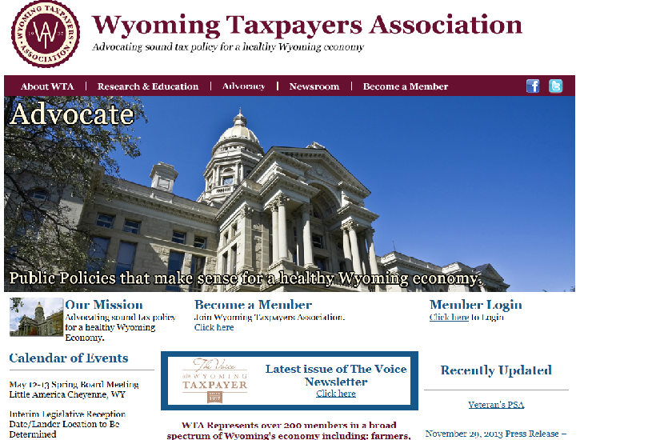
Follow Us!
@wyomingtaxpayersassociation
@wyotax
ashley@wyotax.org
Gain the information you need!
200 E 8th Avenue, Ste. 208
Cheyenne, WY 82001
307.635.8761 o | 30.575.4459 c
www.wyotax.org

